Slide 1
Presentation
Slide design system
Taro Kariya
DENSO INTERNATIONAL AMERICA,INC.
DIAM Corporate Functions
Corporate Communications

Slide 2
Agenda
Basic design element
Layout rule
Chart rule
How to
Template samples

Slide 3
Basic design element
1.

Slide 4
1-0 New slide templates
We have revised the DENSO corporate identity design system (hereinafter called CIS) to send out the Denso brand toward the world with consistency along with establishing the tag line “Crafting the Core”.
Basing on this CIS, we have drawn up the new presentation slide design system so that we can express the Denso brand independently with a feeling of unity.
Create appropriate slides according to the system that defines the slide design and specifications.

Slide 5
1-1 Fonts
Use the specified fonts.
Verdana
Verdana Bold
Body text, footer:
Verdana
* Fonts described above have been reflected for the template text box.
Enter letters in a text box and you will have the specified font reflected on them.

Slide 6
1-2 Basic color
Use DENSO Black for letters.
DENSO Black
Use DENSO Red for letters to be highlighted.
DENSO Red
* You can select colors described above from the color palette. See P.20 for selecting a color.

Slide 7
1-3 Discrimination color
Use the following identification colors only when you need to
discriminate diverse information by charts.
* Do not use discriminating colors for letters.
Crafting Blue
DENSO Gray 2
You can use the following colors by limiting to a small area if you find it difficult to discriminate
letters with the colors described above.
Green
Light Purple
Blue
Deep Blue
Pink
* You can select colors described above from the color palette. See P.20 for selecting a color.

Slide 8

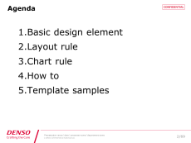
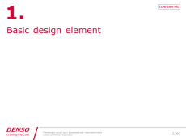


1-4 Page composition
Create a presentation in the following composition.
We recommend that you add a title page if you have many chapters and pages.
Cover
Agenda
Title
Body text
Corporate mark
…
Create a title for every chapter of the agenda.
* See P.56 for setting the template described above.

Slide 9
Layout rule
2.

Slide 10


2-1 Creating a cover
Enter a presentation title, your department and your name in the prescribed text box.
Title area
Font size：34pt
Presenter
Font size：24pt
Department
Font size：16pt
* Fonts described above have been reflected for the template text box.
Enter letters in a text box and you will have the specified font size reflected on them.

Slide 11









2-2 Cover variation
・Specifications common to all businesses
The following three types of designs are available.
・Each business G specification
Covers using the core visual of each business G are available. Do not use covers of other business G.
Electronic Systems
Business G
Powertrain Systems
Business G
Electrification Systems
BusinessG
Thermal Systems
Business G
Information & Safety
Systems Business G
Sales & Marketing G
New Business
Promotion G
* Cover designs will be updated in series. Download the latest data from “CI control system” and
use it.

Slide 12




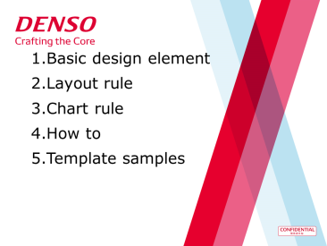
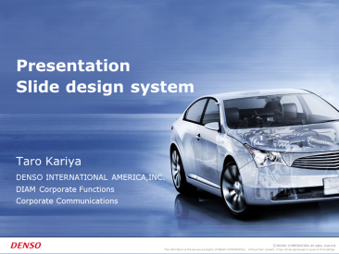
2-3 Cover NG
You may not change covers as shown below.
Do not use other fonts than those specified.
Do not use other font sizes than those specified.
Do not use other colors than those specified.
Do not deform the cover image.
Do not add the agenda.
Do not use the old template.

Slide 13

2-4 Creating an agenda
Write an agenda in a page separated from the cover.
Chapter title
Font size：34pt

Slide 14
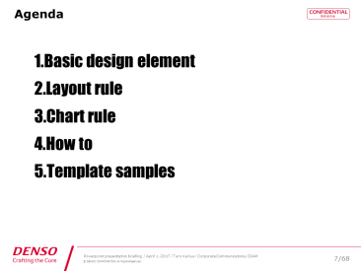
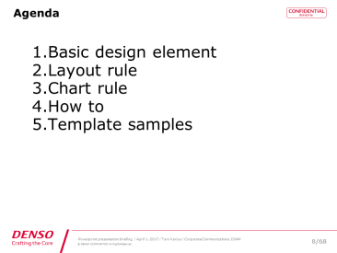
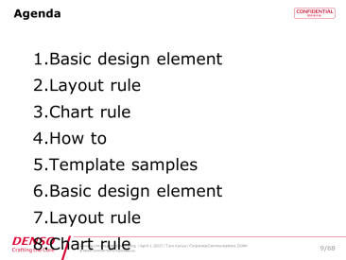
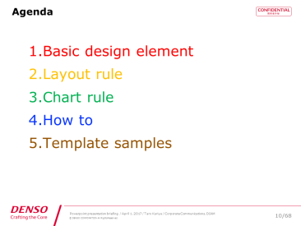
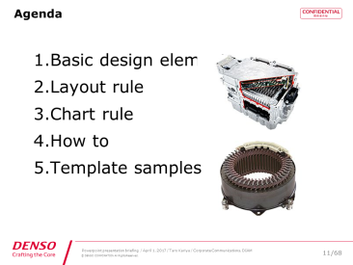
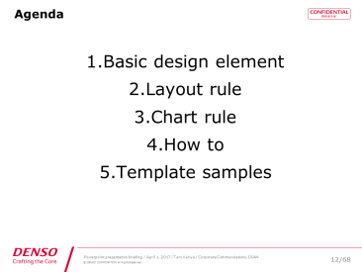
2-5 Agenda NG
You may not change agendas described below.
Do not use other fonts than those specified.
Do not space lines too closely.
Do not have letters run over the footer.
Do not use other colors than those specified.
Do not add an image.
Do not use other layouts than those specified.

Slide 15
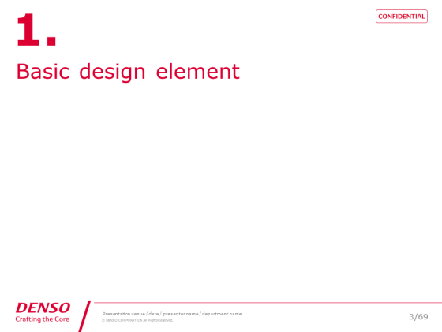
2-6 Title page
We recommend that you add a title page when you change chapters. It prompts participants to become aware of a break of a story and further understand the speech.
Chapter number
Font size：71pt
Chapter title
Font size：34pt
* The font size described above has been reflected for the template text box.
Enter letters in a text box and you will have the specified font size reflected on them.

Slide 16


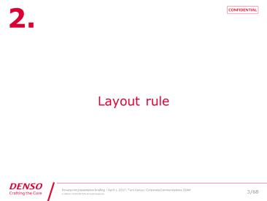
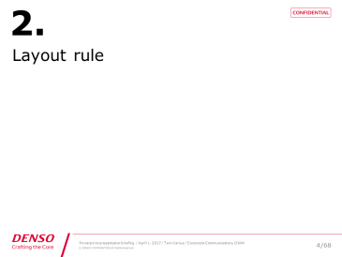
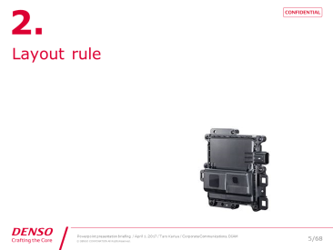

2-7 Title page NG
You may not change title pages as shown below.
Do not use other fonts than those specified.
Do not use other font sizes than those specified.
Do not change the layout to a nonstandard one.
Do not use other colors than those specified.
Do not add an image.
Do not change the background color.

Slide 17
2-8 Layout rule of the text page
One message per slide
Bear in mind to create an easy-to-understand slide instead of forcibly putting everything on one page.
Highly readable layout design
Bear in mind to organize information and create a highly readable layout instead of putting every information fully on a screen. → See P.18 for the detail.
Setting the rule to use fonts
Sort out the priority of information and set font sizes and character types. → See P.19 for the detail.

Slide 18
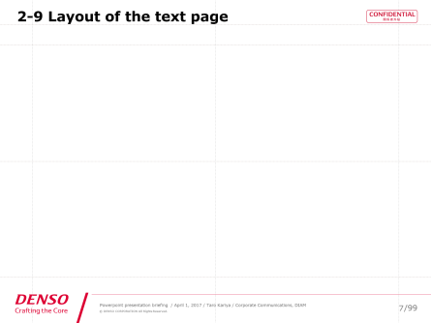
2-9 Layout of the text page
Create a text to fall under the range of the template guide.
Create a text within the range as much as possible as you reduce readability of the text beyond the range.
* Do not change the margin setting of the text box.
Scope of the text
Enter the presentation place (if outside the company), date, name and department in the footer area in English.
* If Guide is not displayed, check [Display] and [Guide] to display the guide.
* See P.57 for changing the footer and the number of total pages.

Slide 19
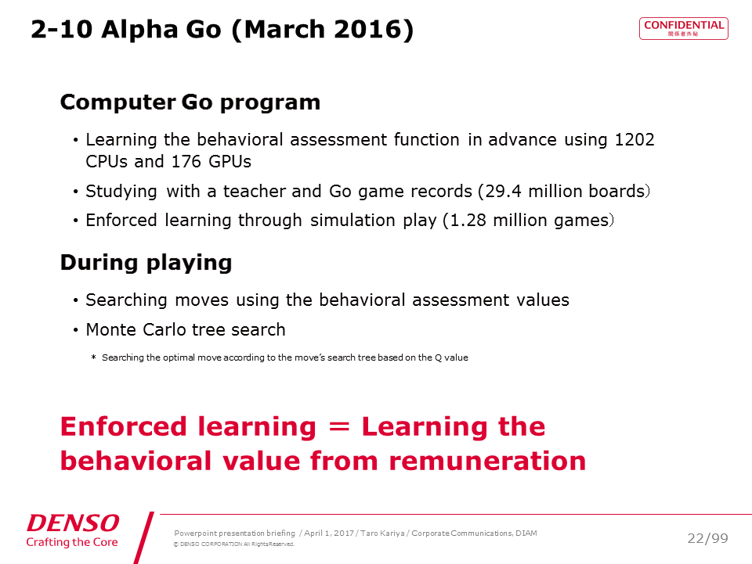
2-10 Font size and type of the text
Use the following font sizes.
* You can use up to 10pt to represent chart values. See P.29.
Title, heading,
conclusion
Size：23-25pt Bold
Text sub title
Size：19-21pt Bold
Text
Size：15pt-19pt
Caption, note
Size：8pt-15pt
Summary
Size：23-25pt Bold

Slide 20
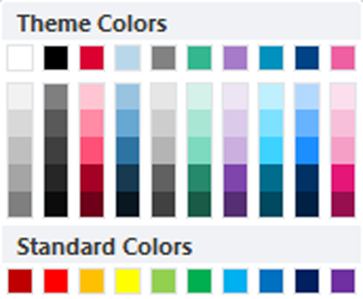
2-11 Letter colors of the text
Basically, use DENSO Black for the text.
Use DENSO Red for the summary and the part to be highlighted.
＊Do not use discrimination colors for letters.
You can use discrimination colors only for charts.
Discrimination colors
White
DENSO
Black
DENSO
Red
Crafting
Blue
DENSO
Gray 2
Green
Light
Purple
Blue
Deep
Blue
Pink
Basic color
Discrimination color

Slide 21
2-12 Capitalization: Title
Capitalize capital letters of words making up the title.
In addition, write prepositions and conjunctions in small letters.
Example
Examined Eco Application
Sensor Requirements for Eco Driving

Slide 22
2-12 Capitalization: Title
Use only the abbreviation (if available) of the technical word contained in the title and describe the official name in the nearest text.
Example
ADAS Sensor Requirements for Eco Driving
Sensors used for Advanced Driver Assistance Systems (ADAS) oﬀer opportunities to improve fuel economy. In this paper, we examine the possibility of additional requirements to achieve fuel eﬃcient driving. In consideration of vehicle electriﬁcation, we assume a vehicle with a regeneration function to clarify the relation between the fuel saving eﬀect and sensor performance by utilizing both a test vehicle and a simulation tool.

Slide 23
2-12 Capitalization: Text
Capitalize the first letter of the specialized terminology (technical term) used in the text.
＊ Abbreviation (such as ADAS): Describe the English official name and describe
the abbreviation in parentheses.
Use the abbreviation from then on.
Example
Sensors used for Automated Driving (AD) and Advanced Driver Assistance Systems (ADAS) offer opportunities to improve fuel economy. In this paper, we examine the possibility of additional requirements to achieve fuel efficient driving.
This work discusses requirements for Multi-channel Operation (MCO) in European C-ITS, and presents multiple concepts required to support MCO.

Slide 24
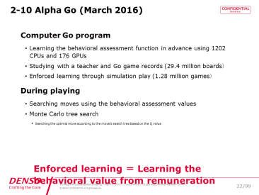
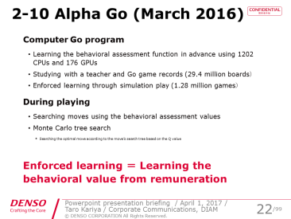
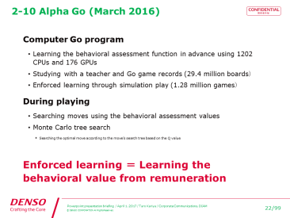
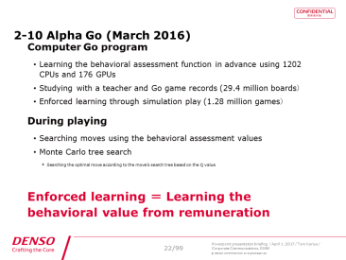
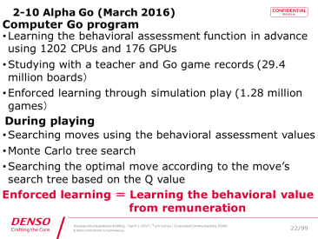
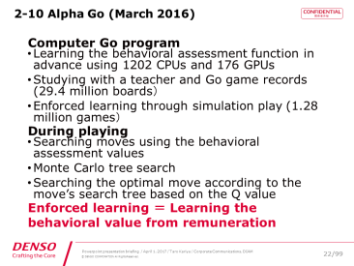
2-13 Layout NG of the text page
You may not change text pages as shown below.
Do not place information on the title footer.
Do not change the font size of the title footer.
Do not change the color of the title footer.
Do not change the character position
of the title footer.
Do not lay out texts beyond the text box.
Do not stuff too much information.

Slide 25
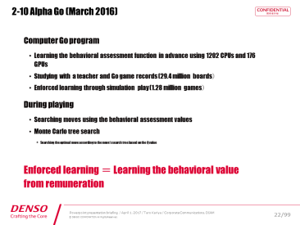

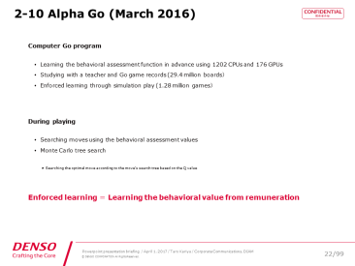
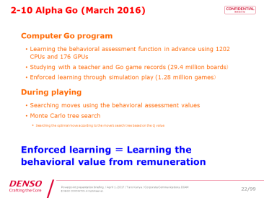
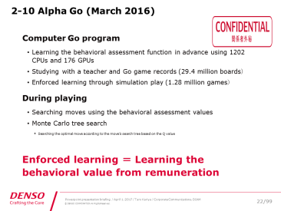
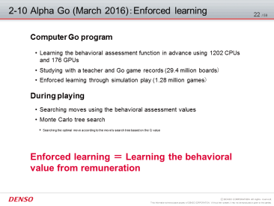
2-13 Layout NG of the text page
You may not change text pages as shown below.
Do not use other fonts than those specified.
Do not use other font sizes than those specified.
Do not use smaller font sizes than
those specified.
Do not use other colors than those specified.
Do not deform classified material images.
Do not use old templates.

Slide 26

2-14 The last page
The last page should be a corporate mark page.
See P.70 for the corporate mark page.
* You may not change the page. Use it as is.

Slide 27
Chart rule
3.

Slide 28
3-1 Basic idea of charts
Charts are important elements in the unified brand presentation of Denso. The rule shown in this section complies with the corporate identity design system (CIS).
Create an appropriate chart and color-code it based on the rule.

Slide 29
3-2 Font size and type in a chart
Use the following font sizes and types.
In a chart
Size：8-16pt
Bold for the title and the
part to be highlighted

Slide 30
3-3 Making appropriate use of colors for a chart
Create a chart basically in DENSO red and monotone gradation. Use DENSO red for important items and the part to show DENSO. Use monotone gradation for others.
You can use discrimination colors if you show parallel relations and have difficulty in color-coding as shown above.
A chart using basic colors
A chart using discrimination colors

Slide 31




3‐4 Capitalization in a chart
Title
Specialized terminology
Hyphenated specialized
terminology
： The first letter of a word is a capital letter.
： The first letter is a capital letter. ex. 「Automated Drive」
： A combination of independent words
→ The first letter of both words is a capital
letter. ex. 「Lane-Merge Assistance」
One word made by combining words
→ Following words are small letters.
ex. 「Take-over of the driving functions」
Take-over Request
(Start driver control)
Start Lane Change
(Virtual leaving highway)
Automated Driving
Margin Distance
Lane-Merge Assistance

Slide 32
3-4 Capitalization in a chart
Capitalize the first letter of words.
Eco Applications Related to ADAS Sensor
Focused Item
ECO-Application | Control Variable | Main Sensing Contents | Main Sensors
ECO Driver Assist | Vehicle Speed | Traffic Sign, Limit Speed | Camera, ADAS Locator
ECO ACC | Vehicle Speed | Preceding Vehicle | Lidar / Radar, V2V, V2X
Cooperative ACC | Vehicle Speed | Multiple Preceding Vehicles | Lidar / Radar, V2V
Eco Lane Change | Route / Path | Surrounding Vehicles, Lane | Camera, Radar, V2V
Green Wave System | Vehicle Speed | Traffic Signal, Intersection | V2X
ECO Routing | Route / Path | Map Info., Traffic Stream | Car Navigation
Battery Management | Amount of Charge | Road Geometry (Slope, Curve) | ADAS Locator

Slide 33
3‐5 Before-and-after of a chart
Actual examples of charts are shown in the following pages.
Use them as a reference to use colors and add descriptions.
・ Create a chart for yourself with Excel and PowerPoint using styles and
color combination shown in the following pages as a reference.
・ You can copy and use a new chart and a tabular composition.
Change the value as needed before using it.
* See “4-5 Styles and color combination of a chart” on P.58 and the following pages for the detail.

Slide 34
3-5 Before-and-after of a chart:
Circle chart
Conventional chart design
New chart design
Germany
UK
India
Singapore
USA
Indonesia
Thailand
China

Slide 35
3-5 Before-and-after of a chart:
Circle chart
Conventional chart design
New chart design
CompanyC
CompanyB
Company C
Company B
Company A
CompanyA
DENSO
DENSO
Germany
UK
India
Singapore
USA
Indonesia
By area
Thailand
China

Slide 36
3-5 Before-and-after of a chart:
Bar chart
Conventional chart design
New chart design
Figure-2 Cooling loss
C
5.1pt
B
5.1pt
C
B
A
A

Slide 37
3-5 Before-and-after of a chart:
Bar chart
Conventional chart design
New chart design
12%
12%

Slide 38
3-5 Before-and-after of a chart:
Bar chart
Conventional chart design
New chart design

Slide 39
3-5 Before-and-after of a chart:
Composite chart
Conventional chart design
New chart design
99.4%
Measured
value
６Ｗ
6W
SiC | Si | Si
2INV |  | L pressure rising
2INV
L pressure
rising

Slide 40
3-5 Before-and-after of a chart:
Area chart
Conventional chart design
New chart design

Slide 41
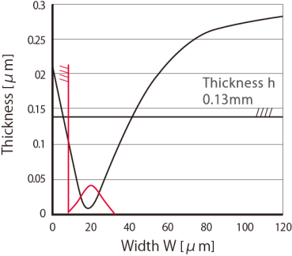
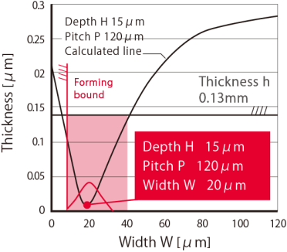
3-5 Before-and-after of a chart:
Area chart
Conventional chart design
New chart design
Forming bound
Efficiency bound
Forming bound
Forming bound
Efficiency
bound
120μm±10μm
Forming bound
厚さh
Depth H 15μm
Pitch P 120μm
15μm±5μm
０．１３mm
15μm±5μm
Thickness h
０．２３mm
0.13mm
0.23mm
Depth H １５μm
Pitch P １２０μm
０．４６mm
0.46mm
Depth H １５μm
Pitch P １２０μm
Calculated line
Forming bound
Depth H １５μm
Pitch P １２０μm
Width Ｗ ２０μｍ

Slide 42
3-5 Before-and-after of a chart:
Line chart
Conventional chart design
New chart design
Target Value:0%
→ less than 2m

Slide 43
3-5 Before-and-after of a chart:
Tabular composition
Conventional tabular composition design
New tabular composition design
Item |  | Development goal
Formation rate［stack/stand］ |  | 6000 or more
Machining cost per stand［Yen/stand］ |  | 2000
Assy characteristic | Radiation performance［ratio］ | Press work fin equivalence
 | Pressure loss［ratio］
 | Cyclic pressure capacity
Fin unit characteristic | Stack height | 10.2±0.08 Cp≧1.3
 | Wave height | 2.0±0.1
 | Appearance | No crack, hole and wrinkle
Item |  | Development goal
Formation rate［stack/stand］ |  | 6000 or more
Machining cost per stand［Yen/stand］ |  | 2000
Assy characteristic | Radiation performance［ratio］ | Press work fin equivalence
 | Pressure loss［ratio］
 | Cyclic pressure capacity
Fin unit characteristic | Stack height | 10.2±0.08 Cp≧1.3
 | Wave height | 2.0±0.1
 | Appearance | No crack, hole and wrinkle

Slide 44
3-5 Before-and-after of a chart:
Tabular composition
Conventional tabular composition design
New tabular composition design
 | C-seg. | E-seg.
Vehicle Weight [kg] | 1500 | 2100
Engine Displacement [L] | 1.8 | 3.5
Battery Capacity [kWh] | 0.3 | 0.5
 | C-seg. | E-seg.
Vehicle Weight [kg] | 1500 | 2100
Engine Displacement [L] | 1.8 | 3.5
Battery Capacity [kWh] | 0.3 | 0.5

Slide 45
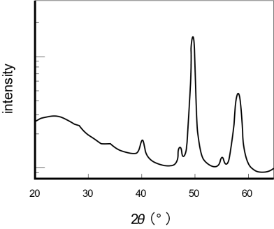
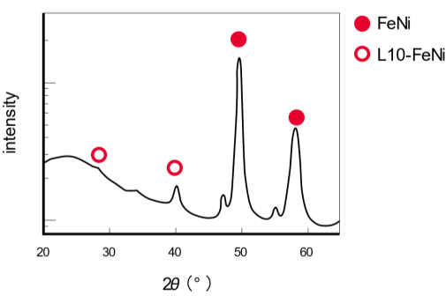
3-5 Before-and-after of a chart:
Analog data
Conventional chart design
New chart design
Figure-1 Synthetic sample pattern
FeNi
L10-FeNi
Figure-1 Synthetic sample pattern

Slide 46
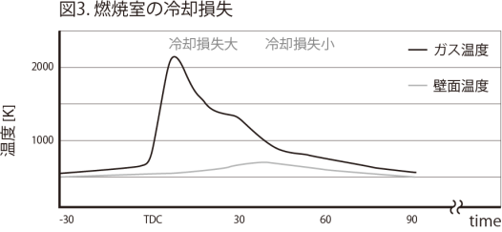
3-5 Before-and-after of a chart:
Analog data
Conventional chart design
New chart design
Fig.3 Cooling loss of the combustion chamber
Fig.3 Cooling loss of the combustion chamber
Big cooling loss
Small cooling loss
Gas temperature
Big cooling loss
Small cooling loss
Gas temperature
Wall temperature
Wall temperature
Temperature[K}
Temperature[K}
t₀
t₁
t₂
t₀
t₁
t₂
Burning
while keeping distance from the wall
Burning in
the entire
combustion chamber
Burning while keeping distance from the wall
Burning in
the entire
combustion chamber

Slide 47
3-5 Before-and-after of a chart:
Flow diagram
Conventional flow design
New flow design
120 pulsed sensor
120 pulsed sensor
Double the
number of teeth.
Double the detection points.
Double the
number of teeth
Double the
detection points
Gear rotor detected
Magnetizing
rotor detected
Gear rotor
detected
Magnetizing rotor
detected
①
③
①
②
③
③
②
Hall element
MR element
Hall element
MR element
Sensor
inoperable
Sensor operation
trouble
Sensor operation
trouble
120 pulse crank angle
sensor implemented
Sensor
inoperable
Sensor operation
trouble
Sensor operation
trouble
120 pulse crank angle
sensor implemented
Figure-1 Technology selection flow
Figure-1 Technology selection flow

Slide 48
3-5 Before-and-after of a chart:
Algorithm
Conventional algorithm design
New algorithm design
Lamp doesn’t work
Lamp doesn’t work
Lamp
plugged in?
No
Lamp
plugged in?
No
Plug in lamp
Plug in lamp
Yes
Yes
Bulb
burned out?
Bulb
burned out?
Yes
Yes
Replace bulb
Replace bulb
No
No
Repair lamp
Repair lamp

Slide 49
How to
4.

Slide 50
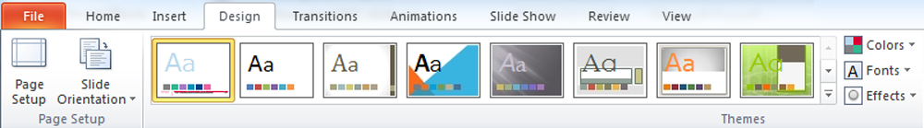
4-1 Setting a color palette (theme)
Save the downloaded template theme on your PC to share the color palette in Microsoft Office (PowerPoint, Excel, Word). Make use of it as needed.
Open [corporate_confidential_4x3_171017.potx].
Click the small arrow of [Others] in [Theme] of the [Design] tab.
Others
* See [Save a theme] of the web page of Microsoft for the detail. https://goo.gl/66PFo0

Slide 51
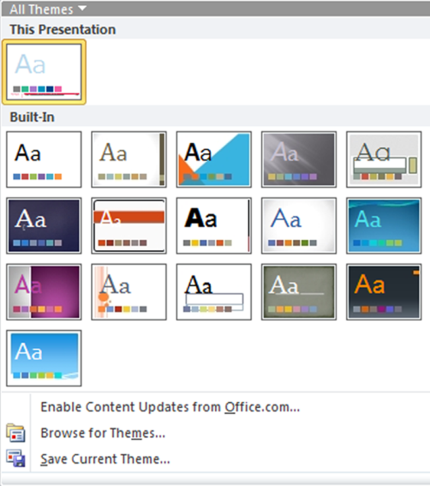
4-1 Setting a color palette (theme)
Click [Save current theme]
Save Current Theme
* See [Save a theme] of the web page of Microsoft for the detail. https://goo.gl/66PFo0

Slide 52
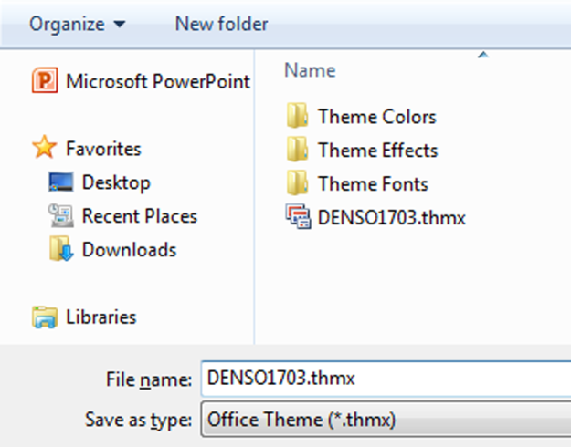
4-1 Setting a color palette (theme)
Enter “DENSO1703” in [File name] and save it in a local file.
A new theme is saved
Enter “DENSO1703”
* See [Save a theme] of the web page of Microsoft for the detail. https://goo.gl/66PFo0

Slide 53
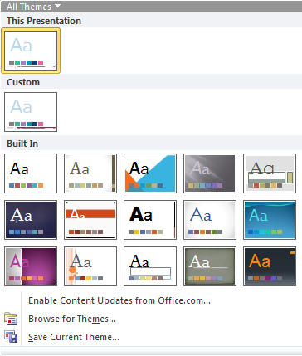
4-1 Setting a color palette (theme)
Make sure that the theme has been added to the user definition.
Added to the user definition
* See [Save a theme] of the web page of Microsoft for the detail. https://goo.gl/66PFo0

Slide 54
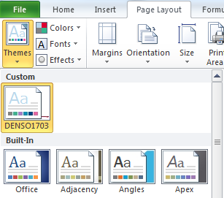
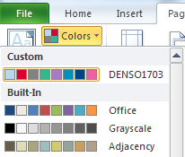
4-1 Setting a color palette (theme)
In Excel and Word, select [Page layout], [Theme] and [DENSO1703] from User definition to set a color palette.
For Excel: Select a theme in User definition.
* See [Apply a document theme] of the web page of Microsoft for the detail. https://goo.gl/bHr5pX

Slide 55




4-2 Data classification template
Templates with three types of data classification images are available besides the basic template. Use them according to the data information.
Basic template
Confidential template
Secret template
Top seclet template
* Download templates from “Public relations” or “CI administration system” and use them.

Slide 56
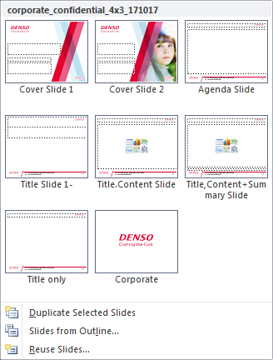
4-3 Selecting a template
Creating a presentation slide
Select an appropriate layout from the slide master to use it.
Slide selection: Right-click and select [Layout]
or select [Home] and [Layout].

Slide 57
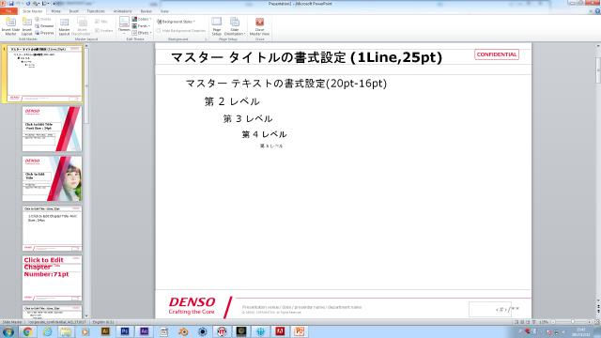
4-4 Changing the footer and the number of total pages
Select [Display], [Slide master] and the top slide master and change the footer and the number total pages (denominator).
Changes are reflected on all corresponding pages.
＊Do not change others than the slide master.
Slide master
Total pages
Enter the presentation location, date, your name
and your department in the footer area in English.

Slide 58
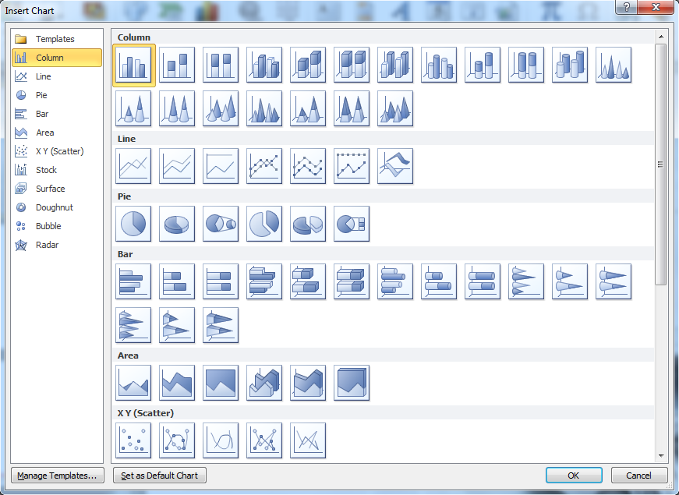
4-5 Styles and color combination of a chart
Create a chart basically in a simple and flat style.
Do not use 3D and shadow effect charts.
* See “3. Chart rule” on P.27 and the following pages for the detail.

Slide 59
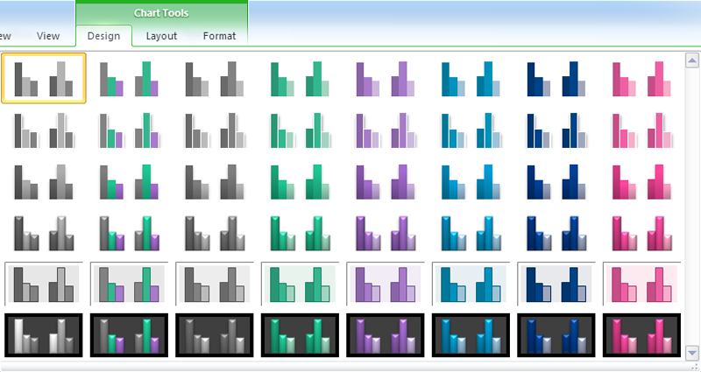
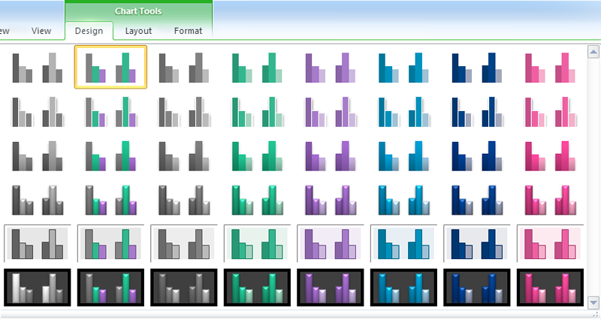
4-5 Styles and color combination of a chart
Basically, select the first monotone style from the left.
Select the second style from the left to create charts in parallel relation.
Do not select 3D and shadow effect charts.
Basic style (basic color)
Parallel relation (discrimination color)
* See “3. Chart rule” on P.27 and the following pages for the detail.

Slide 60
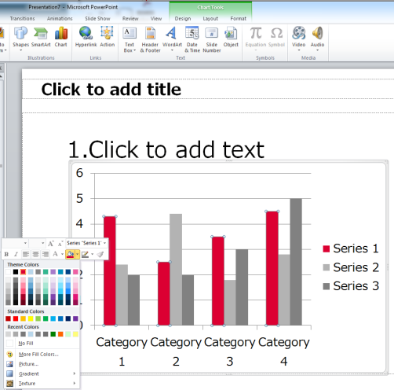
4-5 Styles and color combination of a chart
Select a monotone style and change the most important item in the chart and DENSO area to DENSO Red.
Select the data series and select DENSO Red from [Shape Fill].
* See “3. Chart rule” on P.27 and the following pages for the detail.

Slide 61
4-5 Styles and color combination of a chart
Select a chart color from the color palette according to the rule on P.30.
Discrimination color
White
DENSO
Black
DENSO
Red
Crafting
Blue
DENSO
Gray 2
Green
Light
Purple
Blue
Deep
Blue
Pink
Basic color
Discrimination color
Monotone color
selection area
* See P.7, P.20 and P.30 for the detail.

Slide 62
Template samples
5.

Slide 67
1.

Slide 69
Templates of arrows
We recommend that you use the following data for arrows.
You can change the handle of an arrow.
Copy and use them according to the intended use.
* You can use arrows provided by PowerPoint.
Thin
Thick

