Slide 1
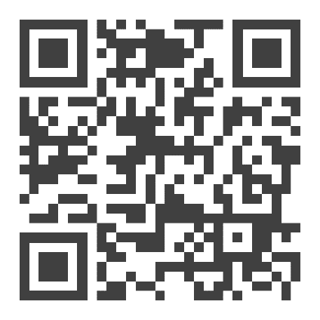
LIKE EXTRA CASH?
$XXXX Bonus Available to YOU for referring a friend or family member to DENSO!
BONUS DETAILS FOR
YOUR REFERRAL
Entry Level Manufacturing
Up to $20.00 with $500 sign on bonus
Experienced Manufacturing
$20.25 with $1,800 sign on bonus and $2,200 commitment bonus
Electricians
Up to $33.75 and sign on bonus up to $15,500, including opportunity for relocation
Machine Repair
Up to $33.75 and sign on bonus up to $11,500, including opportunity for relocation
Skilled Trades – Entry Level Leadership
Up to $36.50 and sign on bonus up to $15,500, including opportunity for relocation
HAVE YOUR REFERRAL APPLY ONLINE
densocareers.com

