Slide 1
Corporate Profile
As of May 2021

Slide 2

Contents
3
4
5
6
7
8-12
13-14
15-16
17
18-22
23-24
25-29
30
31
33-47
Profile
Major Points for Understanding DENSO
The DENSO Philosophy
DENSO Group Long-term Policy 2030
Sustainability Management
Four Focus Fields
Research and Development
Monozukuri
Hitozukuri
Business Overview : Automotive Fields
Business Overview :
Non-Automotive Fields
Main products : Automotive Fields
Main products : Non-Automotive Fields
History of DENSO
Supplementary materials

Slide 3
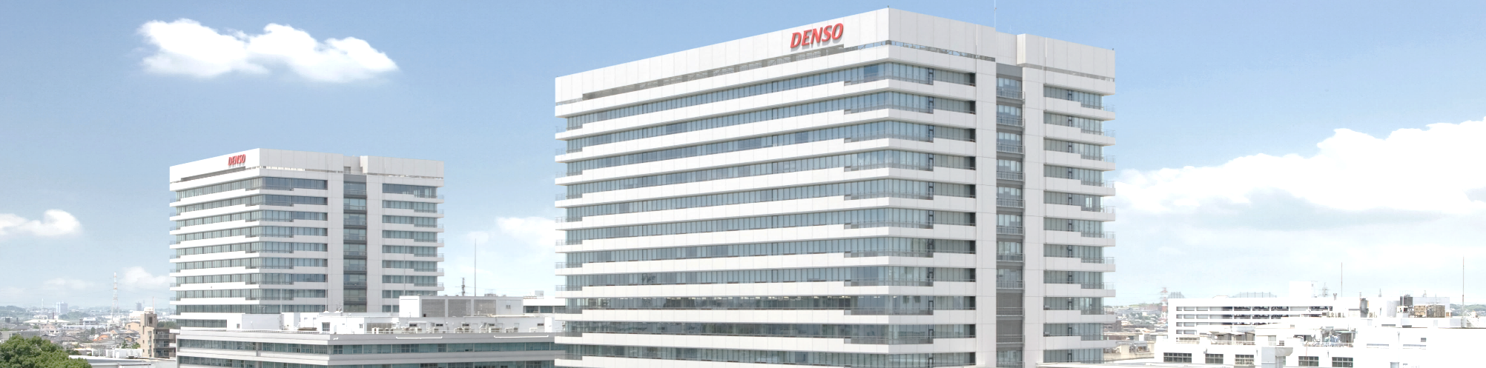
Company Profile
Established | December 16, 1949
Capital | ¥187.5 billion
Revenue | Consolidated basis ¥4,936.7 billion (US$44.6 billion)*
Operating Profit | Consolidated basis ¥155.1 billion (US$1.4 billion)*
Employees | Consolidated basis 168,391
 | Non-consolidated basis 46,272
Consolidated Subsidiaries | 200 (Japan 64, North America 23, Europe 32, Asia 74, Others 7)
Affiliates under the Equity Method | 88 (Japan 24, North America 11, Europe 17, Asia 32, Others 4）
* U.S.dollar amounts have been translated, for convenience only, at the rate of 110.71 yen = US$1,
the approximate exchange rate prevailing on March 31, 2021. Billion is used in the American sense of one thousand million.
as of March 31, 2021

Slide 4
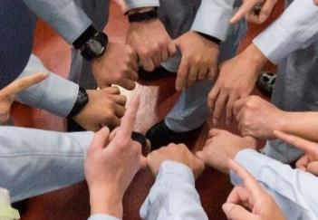
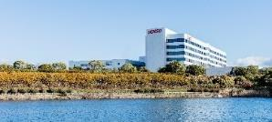

Major Points for Understanding DENSO
DENSO Spirit
Expansive Business Domains
Boldly taking on new challenges no matter
what the circumstances
Clearing the way for future automobiles
through DENSO’s six core businesses that create
green value and provide peace of mind
Number of DENSO Employees Practicing the DENSO Spirit
■ Sensing System,
Semiconductor
■ Thermal Systems
170,000
■ Non-automotive Business (Factory Automation /
Agriculture, etc.)
Consolidated Revenue
■ Powertrain Systems
4.9
trillion yen
■ Other Automotive
■ Electrification
Systems
■ Mobility Systems
Research and Development,
Monozukuri, and Hitozukuri
Global Business Foundation
Leveraging our global foundation to bring happiness
to people around the world and create a better tomorrow
We are committed to creating the best products.
Ratio of Overseas
Revenue to Total Revenue
Ratio of Overseas
Employees*
Consolidated
Subsidiaries
48%
200
53%
Number of
Patents Held Globally
Number of Medals Won at
World Skills Competitions
40,000
69
*Ratio of employees at overseas
subsidiaries to total employees
Notes:
DENSO Spirit
The DENSO Spirit is one of foresight, credibility, and collaboration.
It also embodies the values and beliefs that DENSO has cultivated since its
founding in 1949. The DENSO Spirit permeates the actions of all DENSO employees around the world.
Research and Development, Monozukuri, and Hitozukuri
DENSO’s three greatest strengths are its R&D,
Monozukuri (the art of making things), and Hitozukuri (human resource development).
By having these strengths complement each other,
DENSO is able to push forward with its business activities and provide new value to society.
Expansive Business Domains
Since its founding, DENSO has promoted the development of advanced
technologies related to automobiles. At the same time, the Company has
expanded its business domains by applying these technologies in various fields.
Global Business Foundation
Aiming to be a company that can meet the needs of its various customers
around the world and earn their trust, DENSO has expanded its business with
200 consolidated subsidiaries in 35 countries and regions across the globe.

Slide 5
Mission
Contributing to a better world by creating value together with a vision for the future.
Management Principles
Customer satisfaction through quality products and services.
Global growth through anticipation of change.
Environmental preservation and harmony with society.
Corporate vitality and respect for individuality.
The DENSO
Philosophy
Individual Spirit
To be creative in thought and steady in action.
To be cooperative and pioneering.
To be trustworthy by improving ourselves.

Slide 6
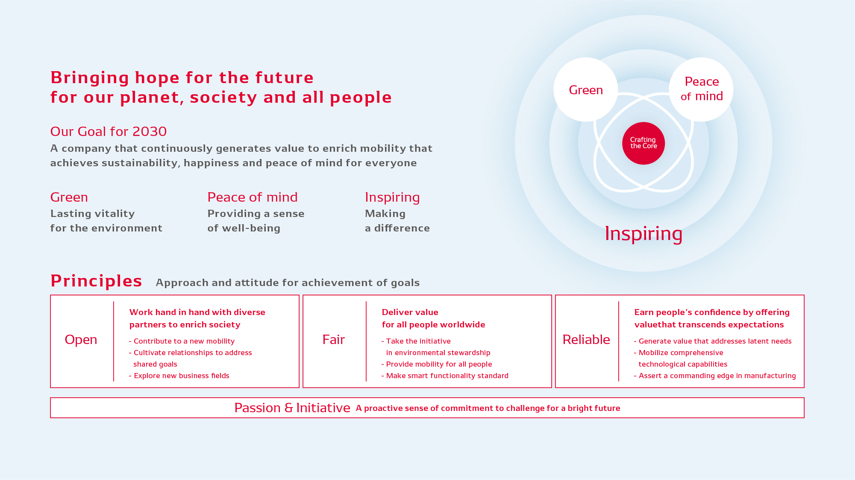
DENSO Group Long-term Policy 2030

Slide 7












Sustainability Management
Sustainable management for DENSO means incorporating SDGs into our management strategy and putting them into practice, through which DENSO is aiming at sustainable growth and improvement in corporate values.
Priority issues for DENSO
Main Targets to be Achieved
through Corporate Activities
Environment
Corporate Foundation
Prevention of global warming
Prevention of air pollution /
Reduction of environmental burden
Effective utilization of resources
Conservation of water resources
Compliance
Information security
Diversity and inclusion
Healthy and safe working environment
Workstyle reform
Protection of human rights
Sustainable procurement
Corporate governance
Peace of Mind
Reduction of traffic accidents
Provision of flexible and comfortable movement
Provision of safe and secure
products
Response to decrease in birthrate and aging population
Main targets to be achieved using products and services

Slide 8

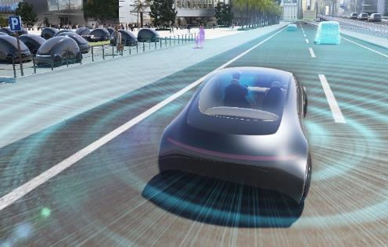

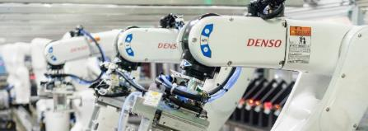
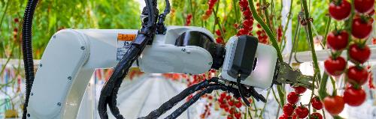
Four Focus Fields
DENSO is contributing to the improvement of both industrial and social productivity by working to provide new mobility value, establish factory automation (FA) and industrialize agriculture.
Advanced Safety and
Autonomous Driving
Electrification
Reducing
environmental burden
and realizing highly
efficient mobility
Realizing a safe society
without accidents,
and free and
comfortable mobility
Non-Automotive
Businesses
(Factory Automation and Agriculture)
Connected Cars
Realizing a new mobile
society that connects
vehicles, people,
and goods
Contributing to
improved social and
industrial
productivity
Notes:
Four Focus Fields
In order to fulfill our slogan of “Bringing hope for the future for our planet, society and
all people”, DENSO is focusing on the fields of electrification, advanced safety and
autonomous driving, and connected driving. We are also working to provide new mobility
value and establish factory automation and agriculture as our non-automotive
businesses. In these ways, we are contributing to the improvement of industrial and
social productivity.
Electrification
DENSO has been engaged in the development of electric vehicle systems that are ecofriendly
and enable even more comfortable travel. As a result, DENSO has realized high
functioning, compact, and fuel-efficient products that are essential for hybrid vehicles
and is producing these products around the world. Going forward, we will leverage our
expansive business domains to form linkages between various in-vehicle systems and
products in an effort to efficiently manage energy within vehicles. In this manner, we will
further improve fuel efficiency and contribute to the conservation of energy.
Advanced Safety and Automated Driving
DENSO aims to create a mobile society without accidents and in which all people
can move safely and with peace of mind. Guided by this aim, DENSO has
developed reliable, high-quality safety technologies. By enhancing our long cultivated
sensing technologies as well as our AI and information technologies, we
will further contribute to the development of autonomous driving.
Maintaining our firm commitment to quality, which we have adopted since our
founding, we will deliver genuine peace of mind for the future of the mobile society.
Connected Cars
Amid the major transition from the trend of owning a vehicle to the trend of using a vehicle as a service,
DENSO is pursuing efforts in the Mobility-as-a-Service (MaaS) business, which involves providing mobility services that move people
and goods.
Going forward, we aim to provide safe, secure, and efficient transportation methods
with low environmental burden for people with vehicles and for those without, thereby contributing to the realization of a new mobile society.
Non-Automotive Businesses (Factory Automation and Agriculture)
DENSO has a solid track record of introducing factory automation (FA)
systems in 130 factories. Leveraging this record, we will propose and provide FA
systems that can meet the diverse needs of our customers, thereby making
extensive contributions to the development of the manufacturing
industry. Also, with the aim of delivering happiness to all people through
agriculture, we will draw on the expertise and know-how we have cultivated in the
automotive field to offer new value in agricultural fields.

Slide 9
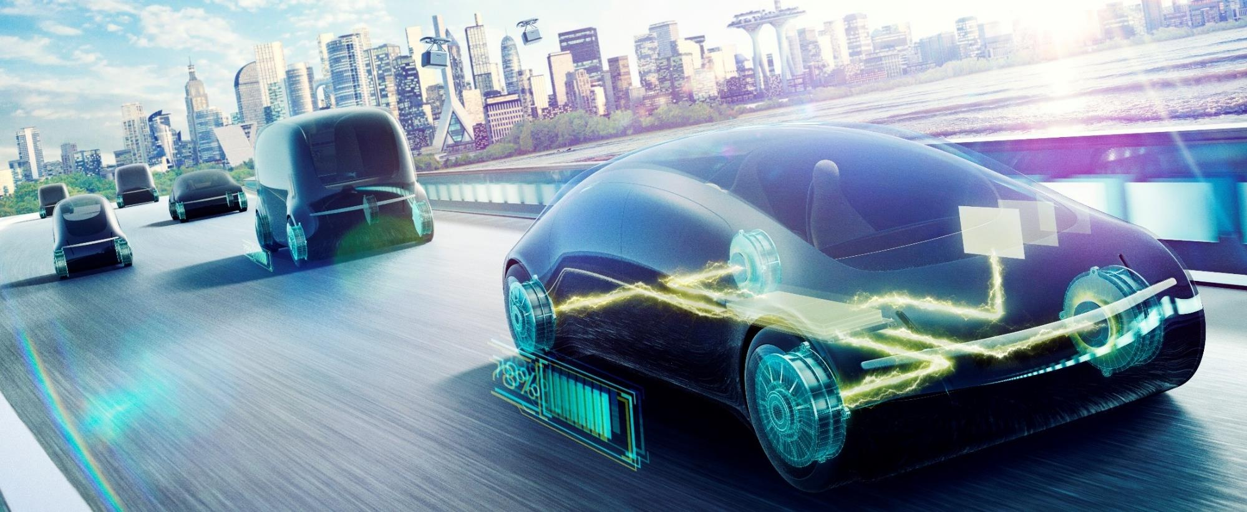
Electrification
DENSO will leverage our expansive business domains to form connections between various in-vehicle systems and products in an effort to efficiently manage energy within vehicles. In this manner, we will further improve fuel efficiency and contribute to the conservation of energy.
Notes:
Reducing environmental burden and realizing highly efficient mobility
DENSO has been engaged in the development of electric vehicle systems that are ecofriendly
and enable even more comfortable travel. As a result, DENSO has realized high
functioning, compact, and fuel-efficient products that are essential for hybrid vehicles
and is producing these products around the world. Going forward, we will leverage our
expansive business domains to form linkages between various in-vehicle systems and
products in an effort to efficiently manage energy within vehicles. In this manner, we will
further improve fuel efficiency and contribute to the conservation of energy.

Slide 10
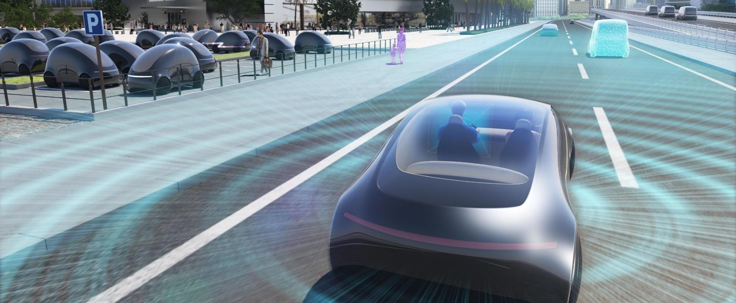
Advanced Safety and
autonomous Driving
By enhancing our long-cultivated sensing technologies as well as our AI and information technologies, we will further contribute to the development of autonomous driving technologies, and deliver genuine peace of mind for the future of mobile society.
Notes:
Realizing a safe society without accidents, and free and comfortable mobility
DENSO aims to create a mobile society without accidents and in which all people
can move safely and with peace of mind. Guided by this aim, DENSO has
developed reliable, high-quality safety technologies. By enhancing our long cultivated
sensing technologies as well as our AI and information technologies, we
will further contribute to the development of autonomous driving.
Maintaining our firm commitment to quality, which we have adopted since our
founding, we will deliver genuine peace of mind for the future of the mobile society.

Slide 11

Connected Cars
DENSO is pursuing efforts in providing mobility services that are convenient, safe, secure, and efficient transportation methods with low environmental burden for people with vehicles and for those without, thereby contributing to the realization of a new mobile society.
Notes:
Realizing a new mobile society that connects vehicles, people, and goods
Amid the major transition from the trend of owning a vehicle to the trend of using
a vehicle as a service, DENSO is pursuing efforts in the Mobility-as-a-Service
(MaaS) business, which involves providing mobility services that move people and
goods.
Going forward, we aim to provide convenient, safe, and secure
transportation methods for people with vehicles and for those without, thereby
contributing to the realization of a new mobile society.

Slide 12
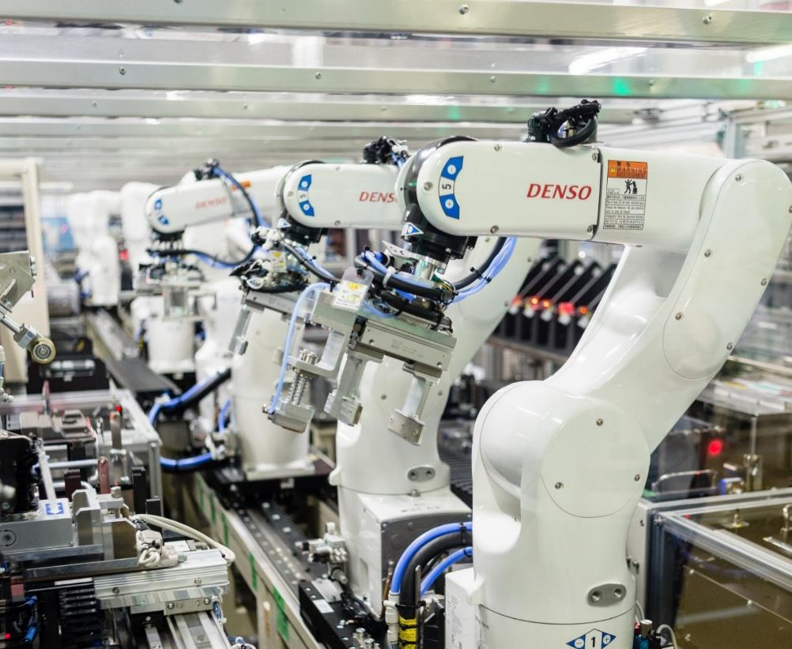
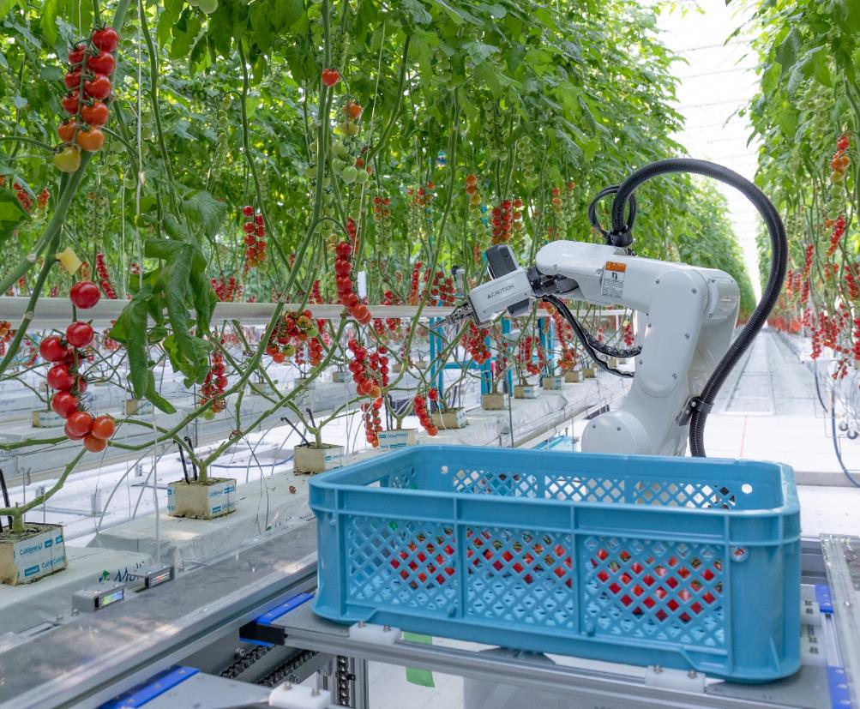
Non-Automotive Businesses (Factory Automation and Agriculture)
DENSO will propose and provide Factory Automation systems that can meet the diverse needs of our customers, thereby making extensive contributions to the development of the manufacturing industry. Also, we will draw on the expertise and know-how we have cultivated in the automotive field to offer new value in agricultural fields.
Notes:
Contributing to improved social and industrial productivity
DENSO has a solid track record of introducing factory automation (FA)
systems in 130 factories. Leveraging this record, we will propose and provide FA
systems that can meet the diverse needs of our customers, thereby making
extensive contributions to the development of the manufacturing
industry. Also, with the aim of delivering happiness to all people through
agriculture, we will draw on the expertise and know-how we have cultivated in the
automotive field to offer new value in agricultural fields.

Slide 13
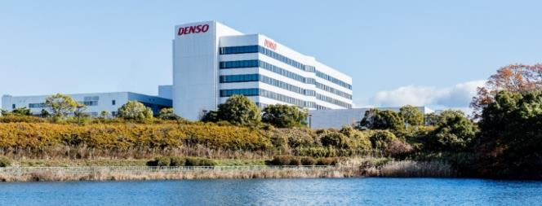
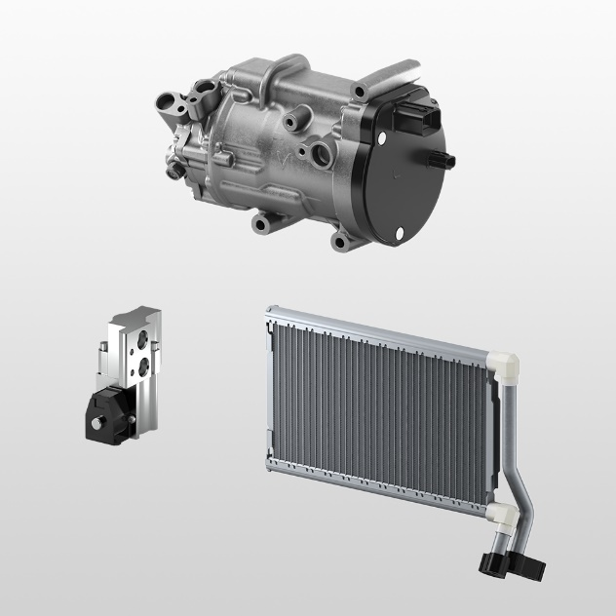
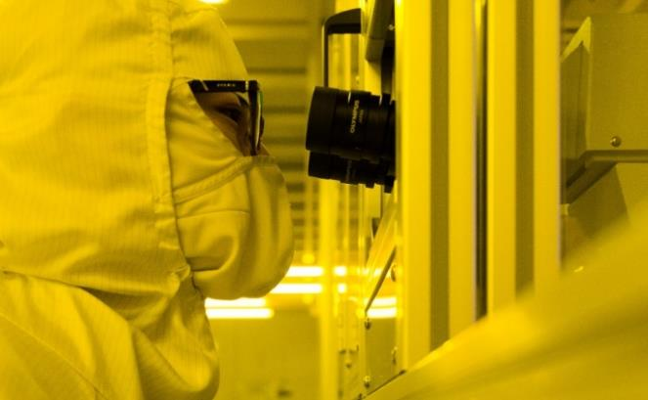
Research and Development
Advanced research focused on the future
Commitment to World-First
We conduct R&D on future technologies, looking five to 20 years ahead.
We have developed more than 130 world-first products that have driven our growth.
Notes:
Research and Development
In research and development—a starting point for creating new value
—DENSO is taking steps to further strengthen planning and R&D
by accurately perceiving society’s needs in order to produce competitive products.
Every year we formulate roadmaps that incorporate changes in regulations and
trends in the global community, deciding what R&D themes are to be started or
terminated.
Advanced Research Focused on the Future
The Advanced Research and Innovation Center were established in 1991.
These laboratories are responsible for long-term R&D and are state-of-the-art
facilities. At these laboratories, we conduct research and development of
future technologies looking five to 20 years ahead. We perform advanced
technology research in a wide range of fields, from power semiconductors such
as silicon carbide (SiC) to key AI technologies for autonomous driving,
which has led to commercialization over the near term.
Furthermore, in order to advance the development of competitive products
in accordance with our customers’ needs, we are locating R&D functions
on the front lines of innovation, such as in Finland and Israel, and establishing
working relationships with various like-minded partners, including local
universities, research organizations, and start-up companies.
Commitment to World-First
Based on our mission of “contributing to people’s well-being through new
value creation,” DENSO is pouring its efforts into creating world-first
products that contribute to the environment, security, and safety.
DENSO has created many world-first products including stereo image
sensors and millimeter-wave radars that help drivers to detect pedestrians and
support pedestrian-avoidance steer assist systems.

Slide 14
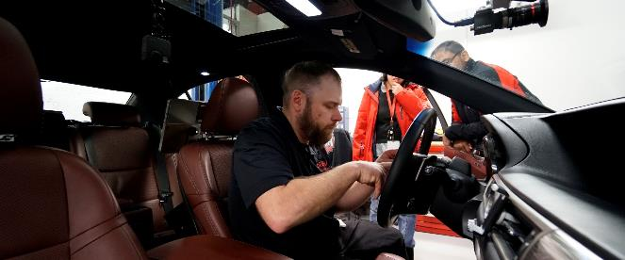

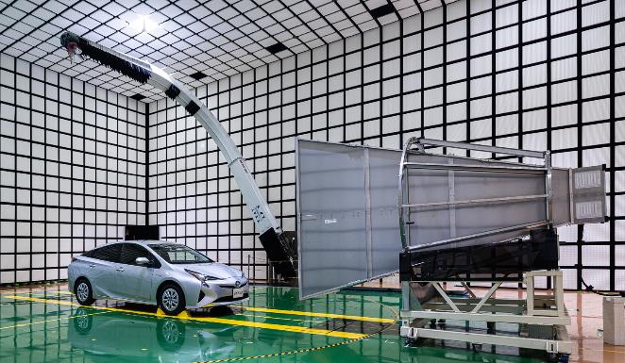
Research and Development
Global R&D structure
Strong partnerships
We operate technical centers in seven regions of the world and laboratories in epicenters of innovation.
We meet the needs of end users through automakers by applying our cutting-edge technologies and accumulated expertise.
Notes:
Global R&D Structure
With technical centers based throughout the world (Japan, the
United States, Germany, China, Thailand, India, and Brazil), DENSO
transcends the internal and external boundaries of the Company and
collaborates with automakers, research institutions, universities, and other
organizations to develop advanced technologies and products that meet
the needs of each region.
Strong Partnerships
DENSO provides technologies and products to the world’s automakers. As
the best partner with the best solutions, DENSO collaborates with
automakers to meet a wide range of end-user needs with technologies and
know-how accumulated through the development of new technologies in every field.

Slide 15
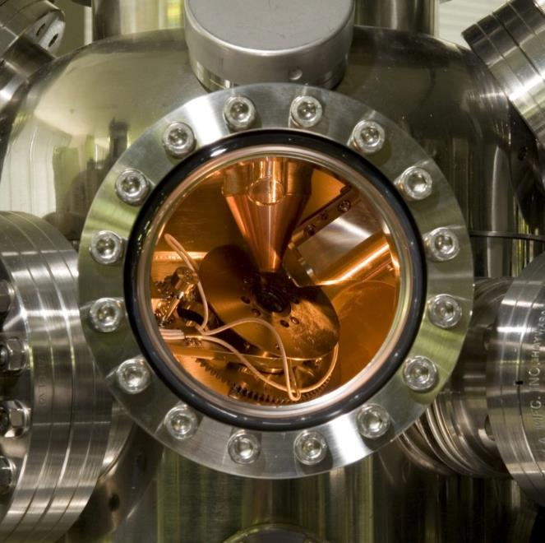
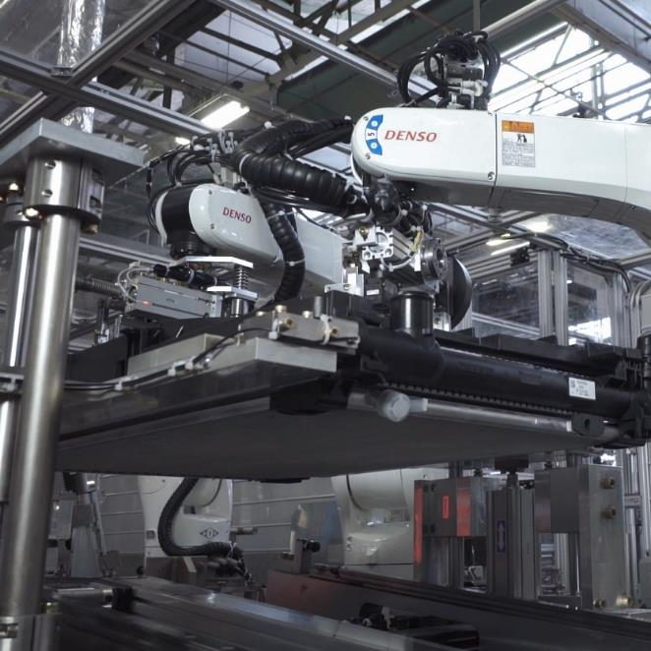
Monozukuri
Materials technology that creates things that don’t exist
Production technology that gives shape to World-First ideas
To improve the performance and quality of products, we carefully select materials and help deliver world-beating performance.
We ensure the quality and performance of world-class products by designing and manufacturing our own equipment and production lines.
Notes:
Monozukuri
Since its inception, DENSO has thoroughly integrated in-house technologies.
Through Monozukuri positive steps are taken to design and manufacture equipment,
production lines, materials, and processing methods.
This enables us to provide society with the world’s most advanced groundbreaking
technologies and products conceived by our R&D.
Materials Technology That Creates Things That Don’t Exist
To pursue product performance and quality, if we don’t have suitable general purpose materials, we create them. This is
part of our commitment to DENSO’s Monozukuri. DENSO’s materials engineers are active on a global scale and
collaborate with materials manufacturers to develop materials that help us achieve world-first products and
world-best performance.
Production Technology That Gives Shape to World-First Ideas
DENSO leverages world-class micro-processing and an assembly line that improves production efficiency and
quality. DENSO also supports world-first products and the world’s highest level of product performance and quality
from a Monozukuri perspective by designing and manufacturing its own equipment and production lines.

Slide 16
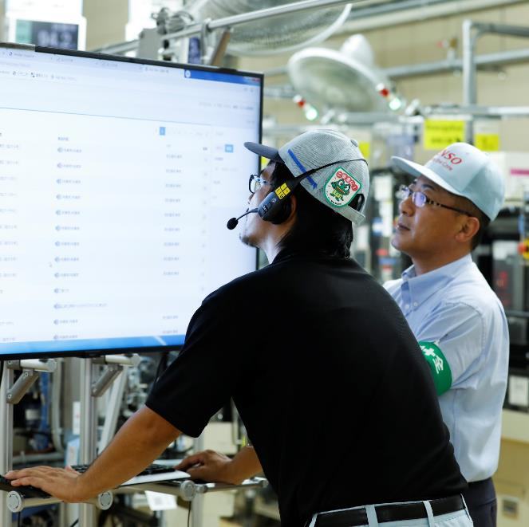
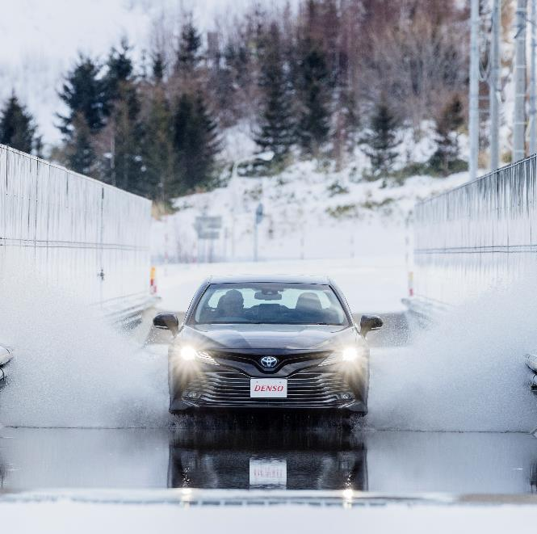
Monozukuri
DENSO’s First-Class factory IoT* that leverages the knowledge of people
Quality Assurance that helps protect precious lives
* Factory Internet of Things
We link 130 plants globally to improve productivity by 30% on a group basis.
We link 130 plants globally to improve productivity by 30% on a group basis.
Notes:
DENSO’s First-Class Factory IoT* That Leverages the Knowledge of People
We take our abundance of data on people, products, and facilities and convert it into valuable information, such as information on signs of equipment flaws and in-formation that contributes to expert know-how.
We offer such information to people that desire it at the times they need it and in a format that they prefer. By doing so,
we are accelerating activities aimed at making improvements and contributing to the growth of people. We aim to form global linkages between our 130 plants in an effort to improve productivity by 30% on a Groupwide basis.
*Factory Internet of Things
Quality Assurance That Helps Protect Precious Lives
Early in our history, DENSO established a proving ground and test chambers, which was very unique for an auto parts
manufacturer. These state-of-the-art facilities, equal to those of auto manufacturers, are used to ensure the quality
and durability of DENSO products and technologies.

Slide 17
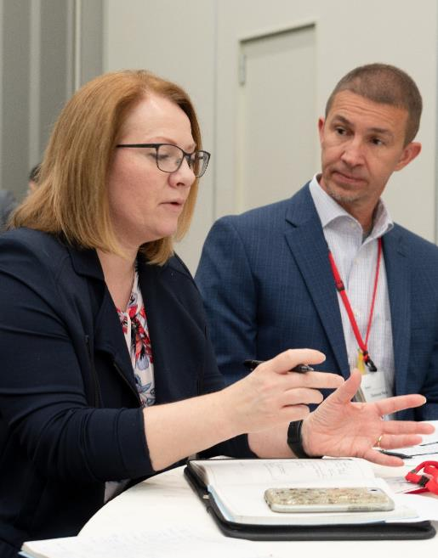

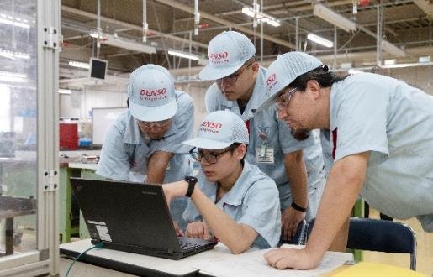
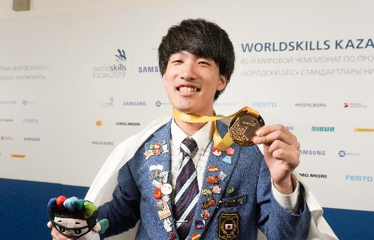
Hitozukuri
Introducing a global “common personnel management system ”
Global opportunities
Nurturing of young technicians
We have made it possible to evaluate and promote global senior staff using a common grading tool.
We offer an overseas trainees program for young employees in their 20s and early 30s.
The DENSO Technical Skills Academy trains and supports technicians of the DENSO Group.
Notes:
Hitozukuri
“The best products are made by the best people.”
DENSO has positioned associates as its most important assets.
That's why DENSO has focused on the training and skill
development of employees based on the idea that human resource development
supports R&D and Monozukuri.
Introducing a Global Common Personnel Management System to Promote the Active Role of a Diverse Group of Employees
In January 2016, DENSO introduced a global common personnel management system targeting the nearly 2,300
members of senior management at its headquarters and at each Group company.
This system incorporates a “Global Individual Grade” that focuses on the individual capabilities of senior management
members. By using a common grading tool to evaluate and promote its senior staff, DENSO allows its personnel around
the world to develop their careers on a global scale. Through this system, DENSO aims to further develop its global
business by recruiting employees with a diverse range of ideas and abilities.
Developing Young Employees Who Will Play Nurturing Young Technicians Global Roles
DENSO implements an overseas training program with the purpose of having employees in their 20s to early 30s
experience different value systems, cultures, and business practices and acquire the necessary experience and
knowledge to be active on a global scale. Every year, nearly 100 employees enter this program and are sent to an
overseas location to work for a maximum of two years. Additionally, we are actively increasing the number of
opportunities for overseas employees to work at our headquarters in Japan. In doing so, we are encouraging our
young employees to develop themselves from a global perspective.
Nurturing Young Technicians
Believing that the development of advanced engineers and technicians who enable innovative product development and
production is the key to corporate growth, DENSO operates the DENSO Industrial School (offering industrial high school
and specialized vocational high school courses), which carries on the tradition of the technical training schools established
in 1954. In addition to domestic Group companies, this school supports the development of technicians from
certain suppliers. Also, we are providing support to develop technicians at our overseas locations in such ways as
establishing training facilities, introducing educational tools, sending lecturers from Japan, and accepting overseas
employees as trainees at the DENSO Industrial School. Many young technicians who have participated in our
educational systems have gone on to become World Skills Competition medalists who compete at the world’s
highest level. At the 44th World Skills Competition, held in Abu Dhabi, United Arab Emirates, in October 2017, 17 of our
technicians from Japan, Thailand, Indonesia, Vietnam, and Mexico competed in eight categories, winning gold and
bronze medals.

Slide 18

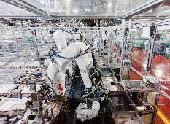
Thermal Systems
Providing safe, comfortable systems that use the least amount of energy possible in consideration of the environment
Comprehensive capabilities for developing and producing car air-conditioning systems
Ability to develop systems such as the world’s first heat pump system for the electrification of cars and cooling systems for power control units (PCUs)
Notes:
Thermal Systems
Providing safe, comfortable systems that use the least amount of energy possible in consider action of the environment
DENSO is using its extensive experience in thermal systems to adapt
to the changes in mobility. Our focus will continue to be on reducing fuel
consumption while offering comfortable thermal management systems and components.
Business Activities
■ Development and production of air-conditioning systems for cars and buses, and cooling systems such as radiators
Features
Comprehensive capabilities for developing and producing car air-conditioning systems
Ability to develop systems such as the world’s first heat pump system for the electrification of cars and cooling systems for power control units (PCUs)

Slide 19

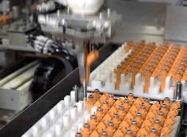
Powertrain Systems
Providing solutions that help overcome the seemingly contradictive task of balancing the joy of driving with superior environmental performance
We maintain and comprehensively develop a wide variety of technologies and systems are active across a broad range of business domains related to powertrains, extending from gasoline and diesel vehicles to hybrid and electric vehicles. We are also able to manufacture products in these domains using highly advanced production techniques.
Notes:
Powertrain Systems
Providing solutions that help overcome the seemingly contradictive task of balancing the joy of driving with superior environmental performance
To reduce the environmental burden of vehicles to the greatest extent possible, we will support the development of internal combustion engines through the pursuit of both environmental and driving performance.
While continuing to provide systems and components, we will strive to create and deliver new value in order to contribute to society as a whole.
Business Activities
■ Development and manufacture of gasoline and diesel engine management systems, which cover everything from combustion to intake and exhaust
■ Development and manufacture of engine-related products, such as variable cam timing (VCT) systems and exhaust gas sensors; and products for drive systems, such as oil pressure control valves
Features
■ We maintain and comprehensively develop a wide variety of technologies and systems are active across a broad range of business domains related to powertrains, extending from gasoline and diesel vehicles to hybrid and electric vehicles. We are also able to manufacture products in these domains using highly advanced production techniques.

Slide 20

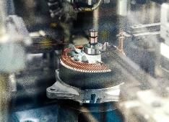
Electrification Systems
Supporting electrification in all areas of mobility to realize an enriched
environment and the joy of driving
Wide variety of technological know-how across a broad range of business domains that extend from internal combustion engine starting systems and power charging products to products powered by electricity such as hybrid cars, electric automobiles, and fuel-cell vehicles. Ability to draw on knowhow and extensive business domains to engage in comprehensive, system-based development.
Notes:
Electrification Systems
Supporting electrification in all areas of mobility to realize an enriched environment and the joy of driving
We have been engaged in the development of electrification technologies for many years. Through
these efforts, we have amassed a solid production track record around the world, enhancing the
performance and reducing the size of key products that are essential for hybrid vehicles while also
realizing reduced fuel consumption. Moving forward, we will leverage the wide range of business fields in which we are involved to form links between various in-vehicle systems and products and thoroughly manage energy efficiency. In these ways, we will further enhance fuel performance and contribute to the conservation of energy.
Business Activities
■Development and manufacture of hybrid and electric car drive systems, power supply and related products, and power supply and starting system parts such as alternators and starters
■Development and manufacture of electric power steering motors, control brake motors, and electric control units(ECUs)
■Development and manufacture of various kinds of small motor system products, such as windshield wiper systems, power window motors, engine control motors, and blower fans
Features
■Wide variety of technological know-how across a broad range of business domains that extend from internal combustion engine starting systems and power charging products to products powered by electricity such as hybrid cars, electric automobiles, and fuel-cell vehicles. Ability to draw on knowhow and extensive business domains to engage in comprehensive, system-based development.

Slide 21
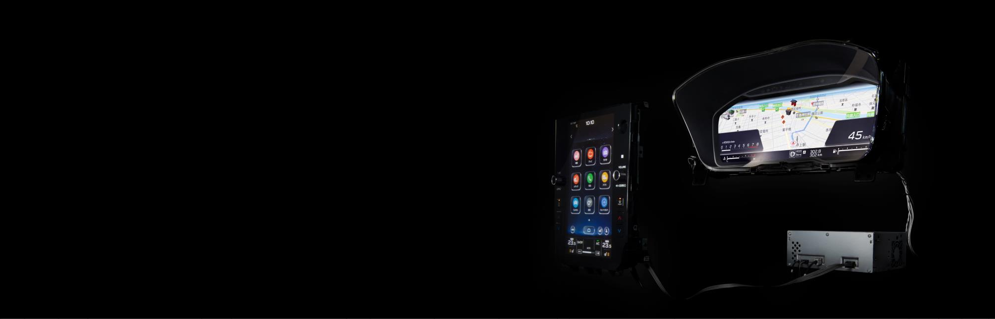

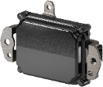
Mobility Systems
Aiming to realize Quality of Mobility* so that all people
can enjoy mobility safely and comfortably
* Refers to enhancing the quality of a mobile society and offering the joy of driving to people all over the world
We have a broad range of technologies that are essential for realizing advanced driver assistance systems (ADAS) and autonomous driving (AD), including road environment recognition, human machine interface (HMI), connected cars, and powertrain control. We are also able to undertake the development of products that draw on our comprehensive strengths in these areas.
By melding the unique value and performance of in-vehicle products with IT products, we are able to build trust with our customers that encourages them to continue using our products with peace of mind. We are also able to develop highly secure products and services that protect the safety of our customers.
Notes:
Mobility Systems
Aiming to realize Quality of Mobility so that all people can enjoy mobility safely and comfortably
DENSO is helping to build a society that is friendly to the environment and that ensures Quality of Mobility by: offering integrated systems, including sensors, semiconductors, engine control units (ECUs), and platforms while taking the initiative in terms of vehicles and end users; by connecting vehicles, which are one means of mobility, with infrastructure; and by building optimally controlled mobility systems.
Business Activities
■ Development and provision of electronic systems, services, and platforms that support all aspects of mobility.
■ Development and manufacture of cockpit products, including HMI control units, meters, head-up displays (HUDs),
air conditioner panels, and driver status monitors(DSMs).
■ Development and manufacture of connected car products, including telematics control units (TCUs), ETC2.0 in-vehicle devices,
and road-to-vehicle and vehicle-to-vehicle communication devices.
■ Development and manufacture of autonomous driving (AD) and advanced driver assistance system (ADAS) products,
including vision sensors, millimeter-wave radar sensors, sonar sensors, driver assistance ECUs, and airbag sensors and ECUs.
■ Development and manufacture of electronics products, including powertrain control ECUs and body control ECUs.
■ Planning and development of retrofit table products, including false acceleration control devices.
Features
■ We have a broad range of technologies that are essential for realizing advanced driver assistance systems (ADAS) and
autonomous driving (AD), including road environment recognition, human machine interface (HMI), connected cars,
and powertrain control. We are also able to undertake the development of products that draw on our comprehensive strengths in these areas.
■ By melding the unique value and performance of in-vehicle products with IT products,
we are able to build trust with our customers that encourages them to continue using our products with peace of mind.
We are also able to develop highly secure products and services that protect the safety of our customers.
HMI: Human Machine Interface HUD: Head-Up Display DSM: Driver Status Monitor
TCU: Telematics Control Unit ETC: Electronic Toll Collection System AD: Autonomous Driving
ADAS: Advanced Driver Assistance System ECU: Electronic Control Unit

Slide 22

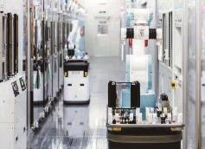
Sensing System, Semiconductor
Pioneering the industry through semiconductor and sensing technologies to realize an eco-friendly, comfortable, and safe mobility and society
Extensive product lineup from sensors to power modules and development capabilities in elemental technologies.
Advanced technological strengths capable of in-house semiconductor manufacturing.
Development capabilities in vertical integration of semiconductors* that satisfy needs for higher functionality and smaller sizes of system products.
*DENSO proprietary integrated semiconductor development, from semiconductors to ECUs and actuators
Notes:
Sensor, Semiconductor
Pioneering the industry through semiconductor and sensing technologies to realize an eco-friendly, comfortable, and safe mobility and society
DENSO will consolidate and greatly enhance its cross-organizational technological development of semiconductors (brain) and sensors (eyes) in order to support innovation in automobiles. Moreover, through the development of electronic elemental technologies that offer value optimized for the new mobile society, we will reduce the environmental burden and help build a society in which people can move safely and with peace of mind.
Business Activities
■ Development and manufacture of microelectronic devices, including in-vehicle power semiconductors, semiconductor sensors, and integrated circuits (ICs).
Features
■Extensive product lineup from sensors to power modules and development capabilities in elemental technologies
■Advanced technological strengths capable of in-house semiconductor manufacturing
■Development capabilities in vertical integration of semiconductors* that satisfy needs for higher functionality and smaller sizes of system products
* DENSO proprietary integrated semiconductor development, from semiconductors to ECUs and actuators

Slide 23
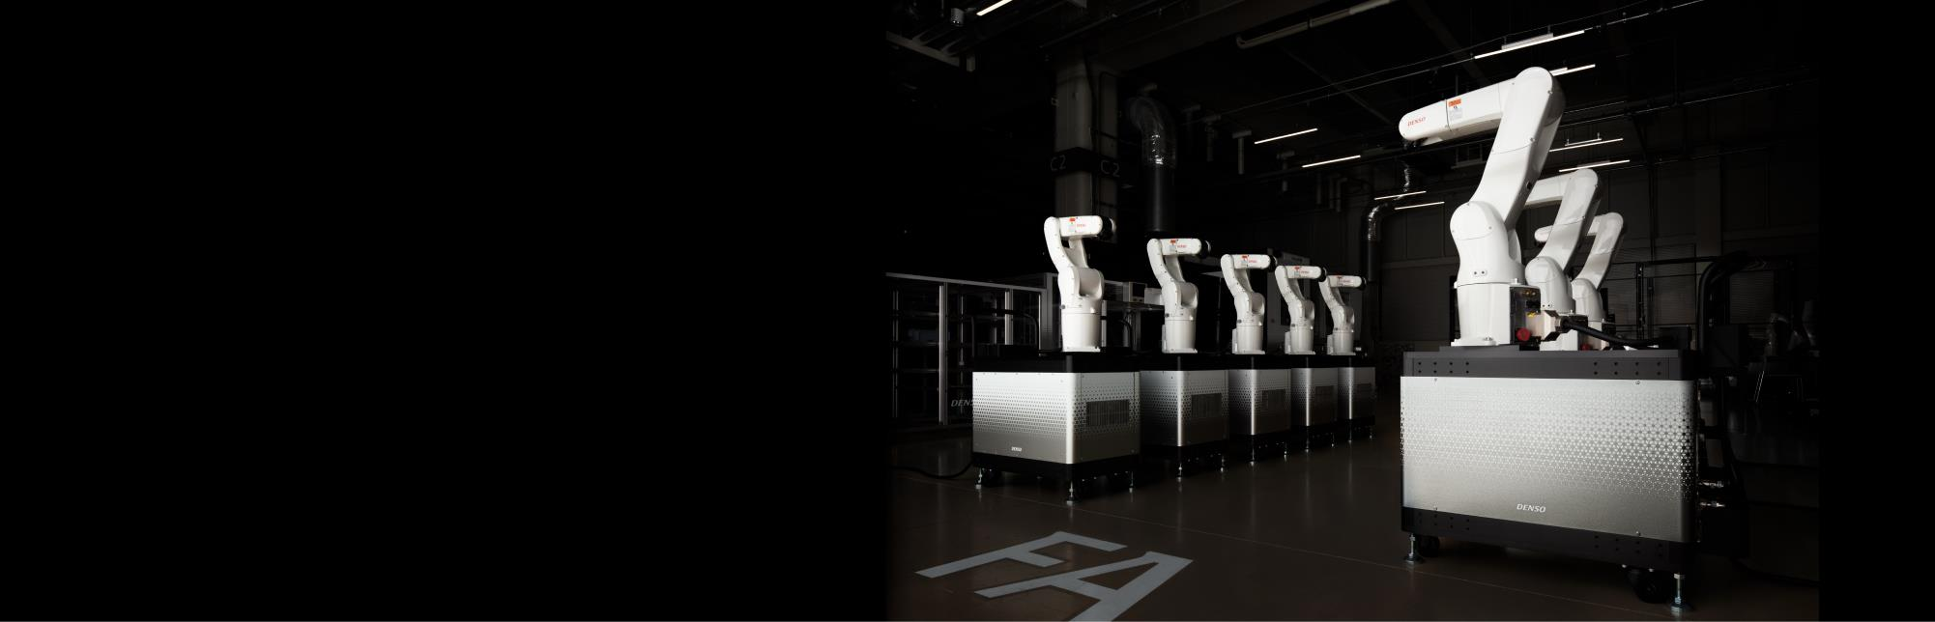
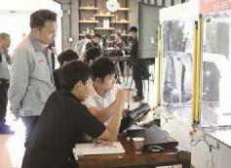
Non-Automotive Businesses: Factory Automation
Enhancing the productivity of the manufacturing industry and contributing to an improved quality of life with a commitment to our long-cultivated technologies
Integration of technologies accumulated in the automotive field and unique technologies created in non-automotive fields
Notes:
Non-Automotive Businesses: Agriculture
Enhancing the productivity of the manufacturing industry and contributing to an improved quality of life with a commitment to our long-cultivated technologies
Business Activities
■Development and manufacture of industrial equipment best exemplified by our automated equipment, modules, and industrial-use robots
■Development and manufacture of equipment for use by society, including handy terminals and QR and RFID payment and recognition solutions, and provision of services
Features
■Integration of technologies accumulated in the automotive field and unique technologies created in non-automotive fields.

Slide 24
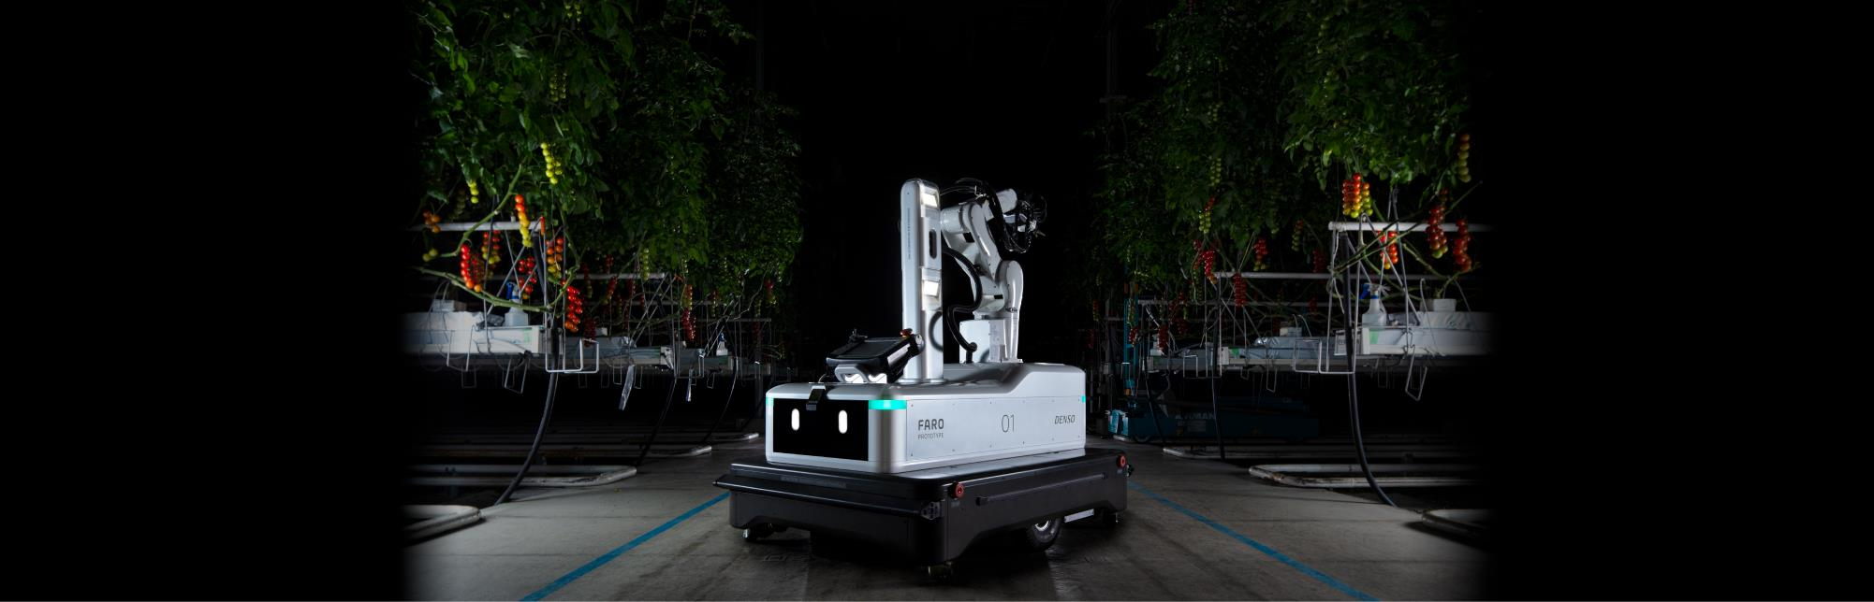
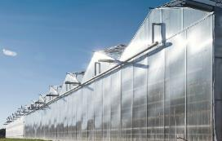
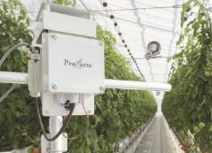
Non-Automotive Businesses: Agriculture
Combining technologies and ideas to contribute to an enriched society
where all people can live safely and with peace of mind
Provision of proposal-based solutions that closely address agricultural producers’ needs and issues
Development of cold chain products that meet a broad range of needs related to food delivery
Notes:
Non-Automotive Businesses: Agriculture
Combining technologies and ideas to contribute to an enriched society where all people can live safely and with peace of mind
In addition to our accumulated technologies to control the environment
in greenhouse cultivation, we will leverage the industrial technologies we have cultivated in the automotive field to
accurately assess the food supply chain, enhance the efficiency of agricultural
production, and realize a safe and stable supply of food.
Business Activities
Provision of proposal-based solutions that closely address agricultural producers’ needs and issues
Development of cold chain products that meet a broad range of needs related to food delivery
Features
■ Provision of proposal-based solutions that closely address agricultural producers’ needs and issues
■ Development of cold chain products that meet a broad range of needs related to food delivery

Slide 25
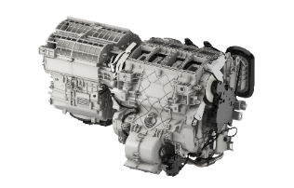

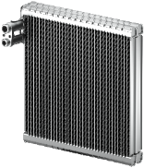
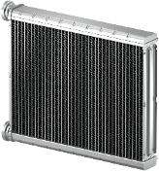
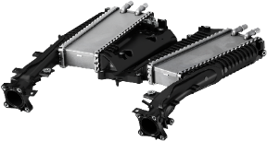
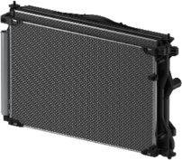
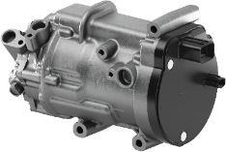
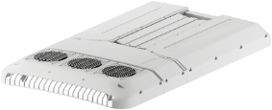

Main products: Thermal Systems
Car Air-conditioner
Condenser
Evaporator
Heater Core
Water Cooled Intercooler
Radiator
Electric Compressor
High Voltage Water Heater
Electric Bus Air-conditioner

Slide 26

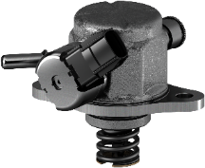

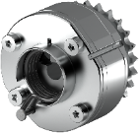



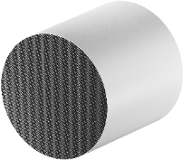




Main products: Powertrain Systems
Direct Injection
High Pressure Injector
Direct Injection High Pressure Pump
Variable Cam Timing
Iridium Spark Plug
Ignition Coil
Oxygen Sensor
Substrate
Common Rail Systems
Accelerator Pedal Module

Slide 27
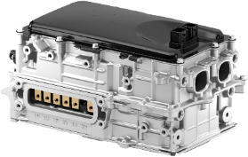
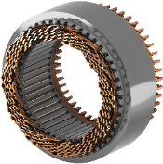
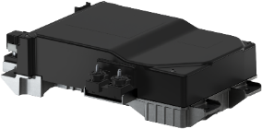
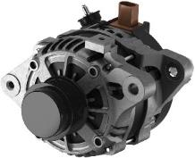
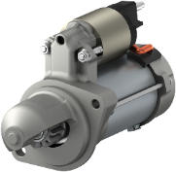
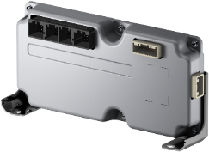



Main products: Electrification Systems
Inverter
Motor Generator
Lithium-ion Battery Pack
Alternator
Starter
Lithium-ion Battery
Electronic Control Unit
Electric Power Steering Motor
Wiper System
Power Window Motor

Slide 28










Main products: Mobility Systems
Stereo Vision Sensor
Millimeter-Wave Radar Sensor
Instrument Cluster
Head-Up Display Unit
Driver Status Monitor
Telematics Control Unit
DCM(Data Communication Module)
ETC and ETC2.0 On-Board Equipment
11.6-inch Touch Display
Engine ECU

Slide 29









Main products: Sensing System, Semiconductor
Solar Sensor
Matrix IR Sensor
Intake Air Pressure Sensor
Engine Oil Level Switch
Steering Torque Sensor
Wheel Speed Sensor
Rain Sensor
Power Module for Automobiles
SiC Power Device for Audio

Slide 30










Main products: Non-automotive business (Factory Automation, Agriculture, Industry/Home)
Automated Modules
QR Solution Services
Spot Cooler
Vertical Articulated Robot
Automated Harvesting Robot
(Under verification testing)
HEMS
(Home Energy Management System)
Collaborative Robots
Environmental Control Systems for
Greenhouse Cultivation
CO₂ Refrigerant Heat-Pumps

Slide 31
History of DENSO
1949
Establishment of NIPPONDENSO CO., LTD., originally named “NIPPON ELECTRICAL EQUIPMENTS CO., LTD.” (currently DENSO CORPORATION)
1977
DENSO employee wins the Gold Medal in the
WorldSkills Competition for the first time
1953
Technical cooperation with Robert Bosch GmbH of Germany is started
1984
Opens Nukata Proving Ground
1954
Establishment of technician training center
1985
Establishment of NIPPONDENSO AMERICA, INC.
(currently DENSO INTERNATIONAL AMERICA, INC.)
and the first overseas technical center near Detroit
1956
Establish mission statement on which DENSO is founded
1991
Opened DENSO Research Laboratories
1961
Receives the Deming Prize
1994
Establishment of the DENSO Philosophy
Develop QR code technology
1966
Establishment of first overseas sales/ service office in Chicago
1996
Renames company DENSO CORPORATION
1968
Establishment of IC Research Center
2005
Establishment of first overseas regional training center in Thailand
1971
Establishment of first overseas subsidiary
company near Los Angeles
Begins shipment of products to
European automotive manufacturers
2016
DENSO ECO VISION 2025
1972
Establishment of first overseas manufacturing companies in Australia and Thailand
2017
Development of DENSOʼs Long-term Policy 2030

Slide 33

Established in 1956
Notes:
１.Be trustworthy and responsible.
Remember that the company is underpinned by trust built up over a long time. Let’s have a strong sense of responsibility to meet the expectations of society and customers.
２.Cherish modesty, sincerity, and cooperation.
Let’s build lasting and valuable personal relationships through honest cooperation and sincere communication, not for appearance’ sake.
３.Be pioneering, innovative, and creative.
Let’s continue research, endeavor to create new solutions, and anticipate and respond to changes with a future vision in mind.
４.Provide quality products and service.
“Quality” means to squarely tackle the changing issues of society and customers in good faith and do our best while always considering how to satisfy customers.
“Provide” means to take a market-oriented approach to offer what customers need, instead of taking a product-oriented approach to sell what we consider good. We must continue to meet customers’ expectations and offer new value.

Slide 34

DENSO Spirit
Established in 2004
Notes:
A spirit of foresight, credibility and collaboration
The DENSO Spirit expresses values and beliefs shared by our employees
around the world that have driven us to contribute to the automotive industry
and society as a whole since our establishment in 1949.

Slide 35

Bringing hope for the future for our planet, society and all people

Slide 36

Principles Approach and attitude for achievement of goals

Slide 37

Business Environment

Slide 38
Revenue Growth/Operating Profit Growth [Consolidated basis]
Revenue Growth
Operating Profit Growth
(billion yen)
(billion yen)
(fiscal year)
(fiscal year)

Slide 39
Consolidated Revenue by Business Group [Consolidated basis]
Other Automotive 6.4％
Non-automotive Business
(Factory Automation / Agriculture, etc.)
3.3％
Thermal Systems
23.6％
Sensing System, Semiconductor
3.0％
Mobility Systems
21.9％
4,936.7
billion yen
April 2020 - March 2021
Powertrain Systems
22.5％
Electrification Systems
19.4％

Slide 40
Consolidated Revenue by Business Group [Consolidated basis]
Aftermarket / Non-automotive Business 11.9％
TOYOTA Group:
TOYOTA,
DAIHATSU, HINO
50.6％
Others 18.8％
4,936.7
billion yen
April 2020 - March 2021
FORD 2.2％
SUBARU 2.3％
GM 2.6％
HONDA
7.5％
FCA, PSA 3.9％

Slide 41

Global Network
32
65
23
15,324
79,267
24,516
519.7
billion yen
3,177.0
billion yen
1,026.2
billion yen
74
7
46,476
2,808
1,303.8
billion yen
40.4
billion yen
The figures for revenue include adjustments between segments.
As of March 31, 2021

Slide 42

Major Locations
Advanced Research
And Innovation
Center
Hirose Plant
Daian Plant
Anjo Plant
Akihabara Innovation
Laboratory
Headquarters
Nishio Plant
Agui Plant
Nukata Proving Ground
Tokyo Office
Takatana Plant
Kota Plant
Tokyo Division
Global R&D Tokyo
Zenmyo Plant
Kosai Plant
Global R&D Tokyo,
Haneda
Toyohashi Plant
Toyohashi East Plant
Shin-Yokohama
Innovation Laboratory
As of April 1, 2021

Slide 43


DENSO Group Main Locations
DENSO CORPORATION
Group Companies -Japan
As of April 1, 2021

Slide 44






Research and Development
Advanced research focused on the future
Commitment to World-First
Global R&D structure
Strong partnerships
The Advanced Research and Innovation Center are responsible for long-term R&D and are state-of-the-art facilities. At these laboratories, we conduct the research and development of future technologies, looking five to 20 years ahead. We perform advanced technology research in a wide range of fields, from power semiconductors such as silicon carbide (SiC) to AI technologies.
Based on our mission of “contributing to people’s well-being through new value creation,” DENSO is pouring its efforts into creating world-first products that contribute to the environment, security, and safety. DENSO has created many world-first products including stereo image sensors and millimeter-wave radars that help drivers to detect pedestrians and support pedestrian-avoidance steer assist systems.
With technical centers throughout the world, DENSO transcends the internal and external boundaries of the Company and collaborates with automakers, research institutions, universities, and other organizations to develop advanced technologies and products.
DENSO provides technologies and products to the world’s automakers.
As the best partner with the best solutions, DENSO collaborates with automakers to meet a wide range of end-user needs with technologies and know-how accumulated through
the development of new technologies in every field.
Notes:
Research and Development
In research and development—a starting point for creating new value
—DENSO is taking steps to further strengthen planning and R&D
by accurately perceiving society’s needs in order to produce competitive products.
Every year we formulate roadmaps that incorporate changes in regulations and
trends in the global community, deciding what R&D themes are to be started or
terminated.
Advanced Research Focused on the Future
The Advanced Research and Innovation Center were established in 1991.
These laboratories are responsible for long-term R&D and are state-of-the-art
facilities. At these laboratories, we conduct research and development of
future technologies looking five to 20 years ahead. We perform advanced
technology research in a wide range of fields, from power semiconductors such
as silicon carbide (SiC) to key AI technologies for autonomous driving,
which has led to commercialization over the near term.
Furthermore, in order to advance the development of competitive products
in accordance with our customers’ needs, we are locating R&D functions
on the front lines of innovation, such as in Finland and Israel, and establishing
working relationships with various like-minded partners, including local
universities, research organizations, and start-up companies.
Commitment to World-First
Based on our mission of “contributing to people’s well-being through new
value creation,” DENSO is pouring its efforts into creating world-first
products that contribute to the environment, security, and safety.
DENSO has created many world-first products including stereo image
sensors and millimeter-wave radars that help drivers to detect pedestrians and
support pedestrian-avoidance steer assist systems.
Global R&D Structure
With technical centers based throughout the world (Japan, the
United States, Germany, China, Thailand, India, and Brazil), DENSO
transcends the internal and external boundaries of the Company and
collaborates with automakers, research institutions, universities, and other
organizations to develop advanced technologies and products that meet
the needs of each region.
Strong Partnerships
DENSO provides technologies and products to the world’s automakers. As
the best partner with the best solutions, DENSO collaborates with
automakers to meet a wide range of end-user needs with technologies and
know-how accumulated through the development of new technologies in every field.

Slide 45




Monozukuri
Materials technology
that creates things that don’t exist
Production technology
that gives shape to
World-First ideas
DENSO’s First-Class factory IoT* that leverages the knowledge of people
Quality Assurance that helps protect precious lives
* Factory Internet of Things
In the pursuit of product performance and quality, if we don’t have the suitable general purpose materials,
we create them. DENSO’s materials engineers collaborate with materials manufacturers to develop materials that help us achieve world-first products and world-best performance.
DENSO leverages world-class micro-processing and an assembly line that improves production efficiency and quality. DENSO also supports world-first products and the world’s highest level of product performance and quality by designing and manufacturing its own equipment and production lines.
We take our abundance of data on people, products, and facilities and convert it into valuable information, such as information on signs of equipment flaws and information that contributes to expert know-how.
We aim to form global linkages between our 130 plants in an effort to improve productivity by 30% on a Groupwide basis.
DENSO makes efforts to improve quality and reliability of products by repeating experiments at the proving grounds and test chambers, which are equal to those of auto manufacturers, where reproduce various driving environments in the world.
Notes:
Monozukuri
Since its inception, DENSO has thoroughly integrated in-house technologies.
Through Monozukuri positive steps are taken to design and manufacture equipment,
production lines, materials, and processing methods.
This enables us to provide society with the world’s most advanced groundbreaking
technologies and products conceived by our R&D.
Materials Technology That Creates Things That Don’t Exist
To pursue product performance and quality, if we don’t have suitable general purpose materials, we create them. This is
part of our commitment to DENSO’s Monozukuri. DENSO’s materials engineers are active on a global scale and
collaborate with materials manufacturers to develop materials that help us achieve world-first products and
world-best performance.
Production Technology That Gives Shape to World-First Ideas
DENSO leverages world-class micro-processing and an assembly line that improves production efficiency and
quality. DENSO also supports world-first products and the world’s highest level of product performance and quality
from a Monozukuri perspective by designing and manufacturing its own equipment and production lines.
DENSO’s First-Class Factory IoT* That Leverages the Knowledge of People
We take our abundance of data on people, products, and facilities and convert it into valuable information, such as information on signs of equipment flaws and information that contributes to expert know-how. We offer such information to people that desire it at the times they need it and in a format that they prefer. By doing so, we are accelerating activities aimed at making improvements and contributing to the growth of people. We aim to form global linkages between our 130 plants in an effort to improve productivity by 30% on a Groupwide basis.
*Factory Internet of Things
Quality Assurance That Helps Protect Precious Lives
Early in our history, DENSO established a proving ground and test chambers, which was very unique for an auto parts
manufacturer. These state-of-the-art facilities, equal to those of auto manufacturers, are used to ensure the quality
and durability of DENSO products and technologies.

Slide 46






Hitozukuri
Introducing a “global common personnel management system ”
Global opportunities
Nurturing of young technicians
DENSO introduced a global common personnel management system targeting the members of senior management at its headquarters and at each Group company. This system incorporates a “Global Individual Grade” that focuses on the individual capabilities of senior management members. By using a common grading tool to evaluate and promote its senior staff, DENSO allows its personnel around the world to develop their careers on a global scale. Through this system, DENSO aims to further develop its global business by recruiting employees with a diverse range of ideas and abilities.
DENSO implements an overseas training program with the purpose of having employees in their 20s to early 30s experience different value systems, cultures, and business practices, and acquire the necessary experience and knowledge to be active on a global scale. Every year, nearly 100 employees enter this program and are sent to an overseas location to work. Additionally, we are actively increasing the number of opportunities for overseas employees to work at our headquarters in Japan. In doing so, we are encouraging our young employees to develop themselves from a global perspective.
Believing that the development of advanced engineers and technicians is the key to corporate growth,
DENSO operates the DENSO Technical Skills Academy (offering industrial high school and specialized vocational high school courses), which carries on the tradition of the technical training schools established in 1954. Also,
we are providing support to develop technicians at our overseas locations in such ways as establishing training facilities, introducing educational tools, sending lecturers from Japan, and accepting overseas employees as trainees at the DENSO Technical Skills Academy .
Notes:
Hitozukuri
“The best products are made by the best people.”
DENSO has positioned associates as its most important assets.
That's why DENSO has focused on the training and skill
development of employees based on the idea that human resource development
supports R&D and Monozukuri.
Introducing a Global Common Personnel Management System to Promote the Active Role of a Diverse Group of Employees
In January 2016, DENSO introduced a global common personnel management system targeting the nearly 2,300
members of senior management at its headquarters and at each Group company.
This system incorporates a “Global Individual Grade” that focuses on the individual capabilities of senior management
members. By using a common grading tool to evaluate and promote its senior staff, DENSO allows its personnel around
the world to develop their careers on a global scale. Through this system, DENSO aims to further develop its global
business by recruiting employees with a diverse range of ideas and abilities.
Developing Young Employees Who Will Play Nurturing Young Technicians Global Roles
DENSO implements an overseas training program with the purpose of having employees in their 20s to early 30s
experience different value systems, cultures, and business practices and acquire the necessary experience and
knowledge to be active on a global scale. Every year, nearly 100 employees enter this program and are sent to an
overseas location to work for a maximum of two years. Additionally, we are actively increasing the number of
opportunities for overseas employees to work at our headquarters in Japan. In doing so, we are encouraging our
young employees to develop themselves from a global perspective.
Nurturing Young Technicians
Believing that the development of advanced engineers and technicians who enable innovative product development and
production is the key to corporate growth, DENSO operates the DENSO Technical Skills Academy (offering industrial high school
and specialized vocational high school courses), which carries on the tradition of the technical training schools established
in 1954. In addition to domestic Group companies, this school supports the development of technicians from
certain suppliers. Also, we are providing support to develop technicians at our overseas locations in such ways as
establishing training facilities, introducing educational tools, sending lecturers from Japan, and accepting overseas
employees as trainees at the DENSO Technical Skills Academy. Many young technicians who have participated in our
educational systems have gone on to become World Skills Competition medalists who compete at the world’s
highest level. At the 44th World Skills Competition, held in Abu Dhabi, United Arab Emirates, in October 2017, 17 of our
technicians from Japan, Thailand, Indonesia, Vietnam, and Mexico competed in eight categories, winning gold and
bronze medals.

Slide 47
























Main products: Automotive business
Thermal Systems
Powertrain Systems
Electrification Systems
Mobility Systems
Sensing System, Semiconductor
Car Air-conditioner
Direct Injection High Pressure Injector
Inverter
Stereo Vision Sensor
Solar Sensor
Water Cooled Intercooler
Common Rail Systems
Motor Generator
Millimeter-Wave Radar Sensor
Steering Torque Sensor
Radiator
Variable Cam Timing
Alternator
Driver Status Monitor
Matrix IR Sensor
High Voltage Water Heater
Accelerator Pedal Module
Wiper System
Engine ECU
Power Module for Automobiles

