Slide 1

DENSO in North America
Company Profile
FY 2022

Slide 2
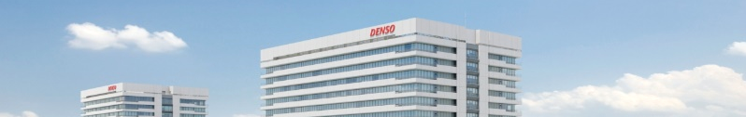
Company name | DENSO CORPORATION
Established | December 16, 1949
Head Office | 1-1, Showa-cho, Kariya, Aichi 448-8661, Japan
Capital | ¥187.5 billion
Revenue | Consolidated basis : $45.1 billion^{*1}
Operating Profit | Consolidated basis : $2.8 billion^{*1}
Profit^{*2} | Consolidated basis : $2.2 billion^{*1}
Employees | Consolidated basis : 167,950
 | Non-consolidated basis : 45,152
Consolidated Subsidiaries | 198 (Japan 63, North America 21, Europe 27, Asia 80, Others 7)
Affiliates under the Equity Method | 84 (Japan 23, North America 11, Europe 17, Asia 29, Others 4）
*1: U.S. dollar amounts have been translated, for convenience only, at the rate of 122.39 yen = US$1, the approximate exchange rate prevailing on March 31, 2022. Billion is used in the American sense of one thousand million.
*2: Profit attributable to owners of the parent company.

Slide 3
DENSO’s Global Network
Europe
Japan
North America
Including DENSO CORPORATION
---- Companies ----
---- Companies ----
---- Companies ----
27
64
21
---- Employees ----
---- Employees ----
---- Employees ----
14,496
79,605
23,604
---- Revenue ----
---- Revenue ----
---- Revenue ----
4.6
billion dollars
28.7
billion dollars
9.5
billion dollars
Asia
Others
---- Companies ----
---- Companies ----
80
7
---- Employees ----
---- Employees ----
47,421
2,824
---- Revenue ----
---- Revenue ----
13.4
billion dollars
0.6
billion dollars
As of March 31, 2022.
The figures for revenue include adjustments between segments.

Slide 4
Mission
Contributing to a better world by creating value together with a vision for the future.
Management Principles
Customer satisfaction through quality products and services.
Global growth through anticipation of change.
Environmental preservation and harmony with society.
Corporate vitality and respect for individuality.
The DENSO
Philosophy
Individual Spirit
To be creative in thought and steady in action.
To be cooperative and pioneering.
To be trustworthy by improving ourselves.

Slide 5
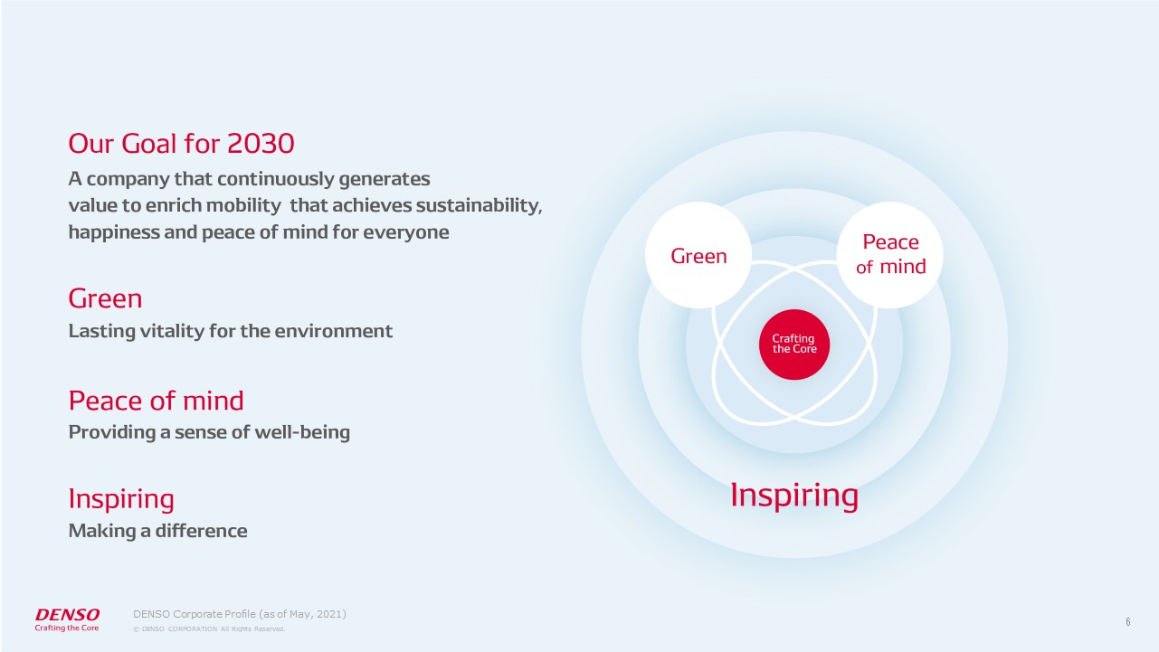

Bringing hope for the future of our planet, society and all people

Slide 6
Business Environment
Society
Mobility
New leaps in information and intelligent technologies
Further diversification in values and consumption patterns
Changes in business models
Paradigm shifts in mobility
New assumptions
Electrification, automated driving, connected vehicles, car sharing and ride sharing
Global warming and air pollution
Increase in traffic congestion
and accidents
Population growth, urbanization and demographic aging
Earlier assumptions
Maintaining and increasing automotive value
Toward 2030
Create inspiring value for society
Maximize value in safeguarding the environment and ensuring peace of mind
Provide value beyond a vehicle-centric focus by embracing society’s broader needs

Slide 7
Business Overview
Contribution to
Long-term Policy
(value of green and peace of mind)
Revenue by
Product
(Ratio)
DENSO operates seven core businesses in a broad range of domains, centered on automotive-related fields.
Segment
Electrification Systems
Green
$8.9 billion
（20.6%）
Powertrain Systems
Green
$9.8 billion^{*2}
（22.6%）
Automotive
Businesses
Peace
of
Mind
$10.6 billion
（23.2%）
Thermal Systems
Green
Peace
of
Mind
$11.4 billion
（24.6%）
Mobility Electronics
Green
Peace
of
Mind
$1.6 billion^{*3}
（3.2%）
*1. Established January 1, 2022 (by integrating the mechatronics components business of powertrain systems and the sensing & semiconductor business)
*2. Consolidated revenue of the former powertrain systems business in FY2022 (ratio)
*3. Consolidated revenue of the former sensing systems & semiconductor business in FY2022 (ratio)
Advanced Devices ^{*1}
Green
Non-
automotive
Businesses
Industrial Solutions
Peace
of
Mind
$1.6 billion
（3.4%）
Green
Food Value Chain
As of March 31, 2022
DENSO in North America Company Profile

Slide 8
Global Consolidated Revenue by Business Group
Other Automotive 2.4％
Non-automotive Business
(Factory Automation / Agriculture, etc.) 3.4％
Thermal Systems 23.2％
Sensing System,
Semiconductor 3.2％
Mobility
Systems 24.6％
45.1
billion dollars
April 2021 - March 2022
Powertrain
Systems 22.6％
Electrification Systems 20.6％
*Indicated based on the business name as of July 1, 2021

Slide 9
Global Sales by Customer
Aftermarket/Non-automotive Business 11.6％
TOYOTA Group:
TOYOTA,
DAIHATSU, HINO
51.4％
Others 19.6％
45.1
billion dollars
April 2021 - March 2022
FORD 2.4％
SUBARU 2.0％
GM 2.3％
HONDA
7.1％
FCA, PSA 3.6％

Slide 10

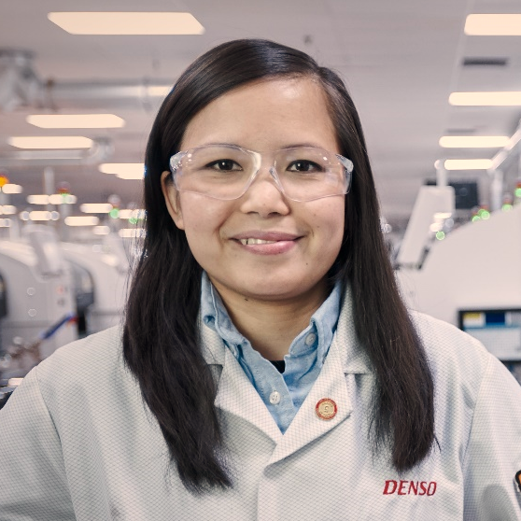














Sustainability Management
DENSO aims to be a force for good, whether it’s crafting technology that improves the safety and efficiency of vehicles, or in our sustainable management of all of our facilities.
Main Targets to be Achieved
through Corporate Activities
Promoting Diversity & Inclusion
Ways of Working with Tremendous Speed and Efficiency
Work Reform
Management Reform
Main targets to be achieved using products and services
Communication
Reform

Slide 11
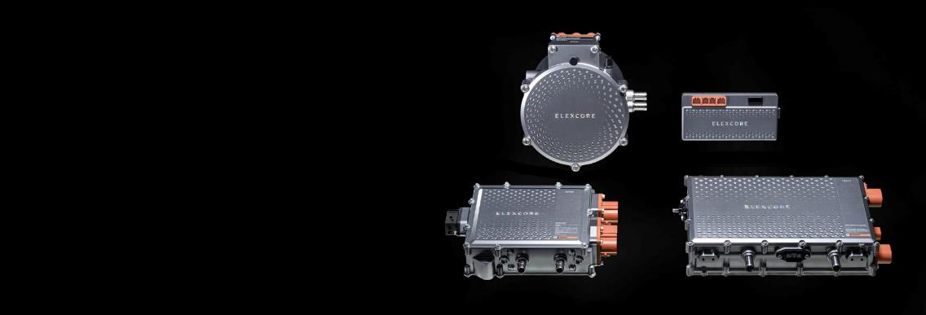
Automotive Businesses
Electrification Systems
Supporting electrification in all areas of mobility to realize an enriched environment and the joy of driving
Features
Wide variety of technological know-how across a broad range of business domains that extend from internal combustion engine starting systems and power charging products to products powered by electricity such as HEVs, BEVs, and FCEVs. Ability to draw on know-how and extensive business domains to engage in comprehensive system-based development
Green

Slide 12
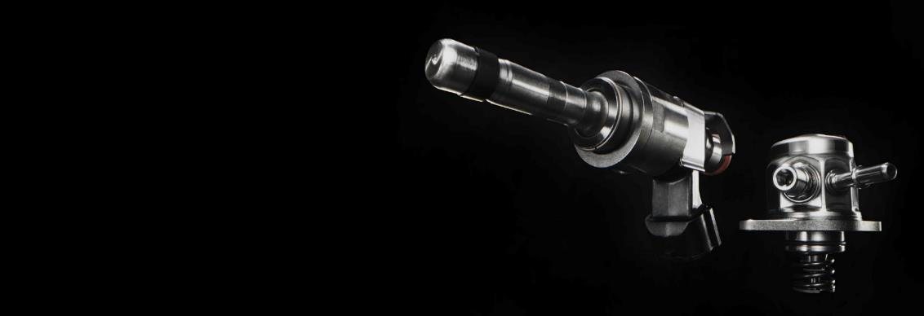
Automotive Businesses
Powertrain Systems
Solutions that achieve the optimum balance of performance, eco-friendliness and flexible mobility ― for all vehicle types.
Features
From the perspective of systems, we maintain and comprehensively develop a wide variety of technologies and are active across a broad range of business domains related to powertrains, extending from gasoline and diesel vehicles to xEVs. We are also able to manufacture products in these domains using highly advanced production techniques
Green

Slide 13

Automotive Businesses
Thermal Systems
Contributing to a more pleasant society for the earth and its people through eco-friendly heat management technologies and comfortable vehicle interiors
Features
Comprehensive capabilities for developing and producing car air-conditioning systems
Ability to develop heat management technologies cultivated in the thermal domain, such as car air-conditioning systems and radiators, as well as heat management products for xEVs that leverage these technologies, such as heat pump systems and cooling systems for power control units (PCUs)
Green
Peace
of
Mind

Slide 14

Automotive Businesses
Mobility Electronics
Realizing a society in which all people can move comfortably and with peace of mind (Quality of Mobility)
Features
Broad range of technologies, including road environment recognition, HMI, connected driving, and powertrain ECUs. Ability to undertake the development of products that draw on the competitive strengths of these technologies
Ability to develop products with outstanding levels of reliability and security by melding the unique value and performance of in-vehicle products with IT products
Green
Peace
of
Mind

Slide 15

Automotive Businesses
Advanced Devices
Using semiconductors to power systems and devices that help build a better society and address social issues including mobility
Features
Apply flexible product development capabilities through the use of extensive sensing and actuation technologies
Development of custom ICs that meet the needs for higher functionality and miniaturization in line with the evolution of car electronics
Develop and manufacture silicon/SiC power semiconductors and power modules, and build a strong supply foundation through collaboration with partners
Green
Peace
of
Mind

Slide 16
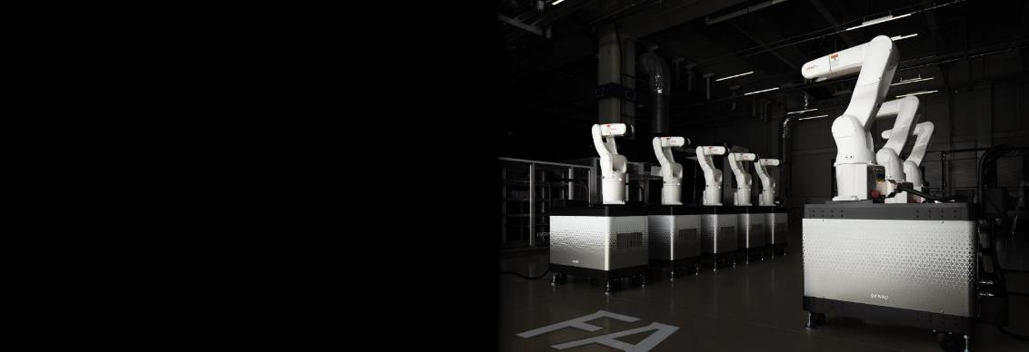
Non-automotive Businesses
Industrial Solutions
Enhancing the productivity of the Monozukuri (manufacturing) industry and improving quality of life
Features
Monozukuri (manufacturing)-related know-how and skills that have served as DENSO's competitive edge over the 70 years since the Company's establishment as well as high-quality, highly durable production assets such as the facilities and robots that we have verified and refined at our 130 factories across the globe
Green
Peace
of
Mind

Slide 17
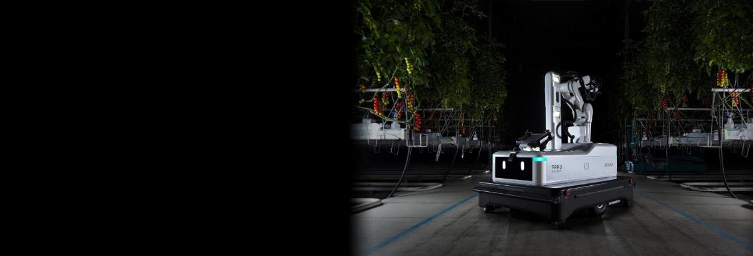

Non-automotive Businesses
Food Value Chain
Combining technologies and ideas to provide new value and contribute to a society where all people can live safely and with peace of mind
Features
Proposal of optimal horticultural facility-related product combinations that integrate cutting-edge technologies from Europe and other regions advanced in agriculture to address the individual needs and issues facing agricultural producers
Provision of high-quality cold chain products that meet a broad range of needs related to food delivery
Green
Peace
of
Mind

Slide 18
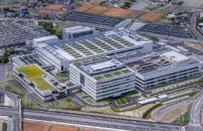
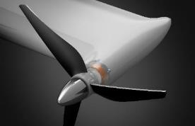
Aiming to Become Carbon Neutral by 2035
Green
Monozukuri (Manufacturing)
Mobility Products
Energy Use
Realize carbon
neutrality at our plants
Contribute to the electrification of
cars to reduce CO₂ emissions to
the greatest extent possible
Capture and reuse CO₂
to contribute to carbon neutrality
within society as a whole

Slide 19
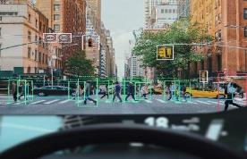
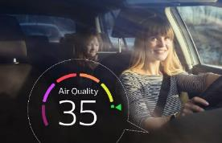
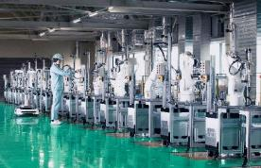
Peace
of
Mind
Aiming to Become a Leading Company That Provides “Peace of Mind” to Society
Creation of
Comfortable Spaces
Zero Traffic Fatalities
Support for Working People
Popularize safety products through efforts
focused on “depth” and “width,” thereby
realizing free mobility without traffic accidents
Enhance relevant technologies for
creating peaceful,
comfortable spaces
Draw on the technologies we have
calculated in the automotive domain to
establish a society where people are
supported and their potential is nurtured
DENSO In North America Company Profile

Slide 20
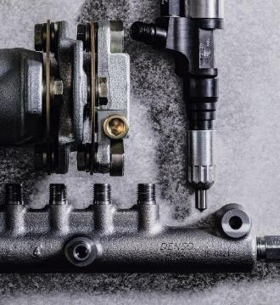
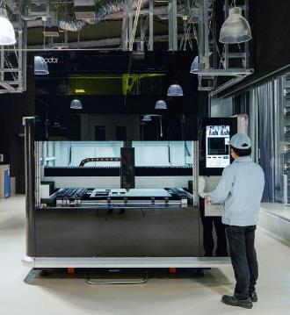
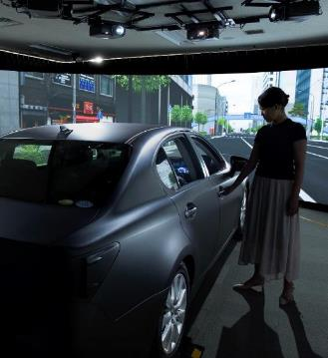
Research and Development
Technical Centers in Seven Regions throughout the World and Laboratories in Epicenters of Innovation
Advanced Research That Estimates and Anticipates the Future Mobility Society
Creating over 130
World-First Products

Slide 21

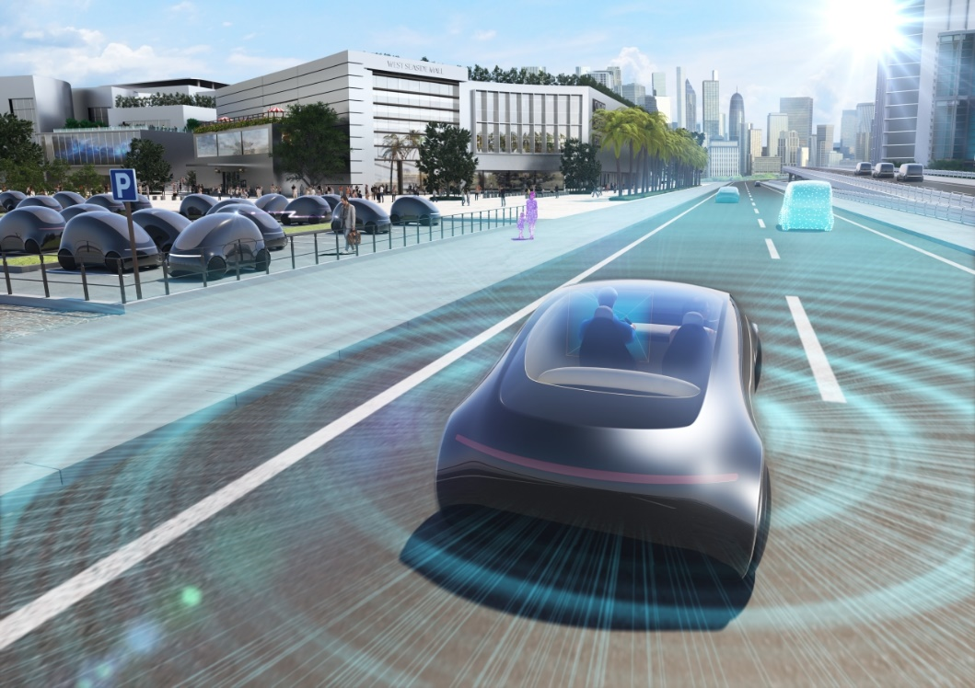
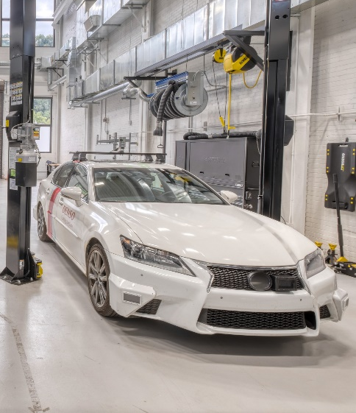
Research and Development in North America
Seattle
Connected Architecture
Ann Arbor
Smart Mobility Eco-System
Montreal
Artificial Intelligence
Silicon Valley
Innovation Research
West Michigan
Digital Key
Mayfield
Vehicle MRI
Southfield
Standardization, Collaboration
Pittsburgh
Automated Driving
San Diego
Connected Technology
Plano
Connected Business
The Seattle Innovation Lab develops connected technologies to advance DENSO’s Mobility-as-a-Service (MaaS) platform. The lab supports recent expansions into software-based solutions to complement its hardware expertise and helps actualize DENSO’s long-term strategy to create new value for future mobility.
At the Pittsburgh Innovation Lab, DENSO conducts research to achieve Level-4 automated driving and develops the elemental technologies, including AI, to make it possible. The lab will work in collaboration with local universities and companies in Pittsburgh, which is a growing tech hub.
Accelerating DENSO technology innovation through participation in the NA R&D ecosystem with
diverse partnerships.

Slide 22
History of DENSO
1949
Establishment of NIPPONDENSO CO., LTD., originally named “NIPPON ELECTRICAL EQUIPMENTS CO., LTD.” (currently DENSO CORPORATION)
1977
DENSO employee wins the Gold Medal in the
WorldSkills Competition for the first time
1953
Technical cooperation with Robert Bosch GmbH of Germany is started
1984
Opens Nukata Proving Ground
1954
Establishment of technician training center
1985
Establishment of NIPPONDENSO AMERICA, INC.
(currently DENSO INTERNATIONAL AMERICA, INC.)
and the first overseas technical center near Detroit
1956
Establish mission statement on which DENSO is founded
1991
Opened DENSO Research Laboratories
1961
Receives the Deming Prize
1994
Establishment of the DENSO Philosophy
Develop QR code technology
1966
Establishment of first overseas sales/ service office in Chicago
1996
Renames company DENSO CORPORATION
1968
Establishment of IC Research Center
2005
Establishment of first overseas regional training center in Thailand
1971
Establishment of first overseas subsidiary
company near Los Angeles
Begins shipment of products to
European automotive manufacturers
2016
DENSO ECO VISION 2025
1972
Establishment of first overseas manufacturing companies in Australia and Thailand
2017
Development of DENSOʼs Long-term Policy 2030

Slide 23
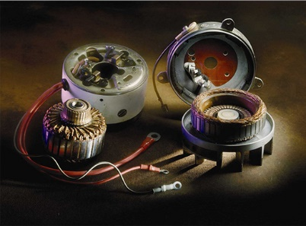
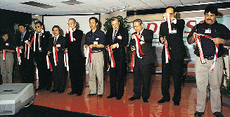
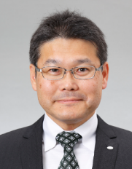
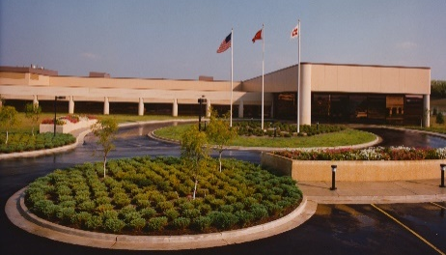
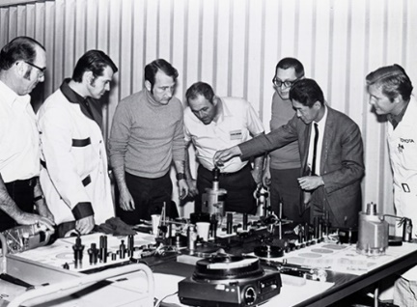

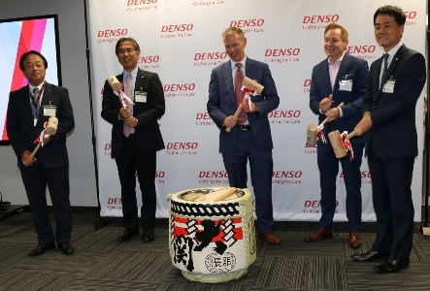
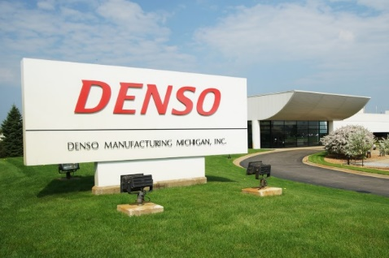
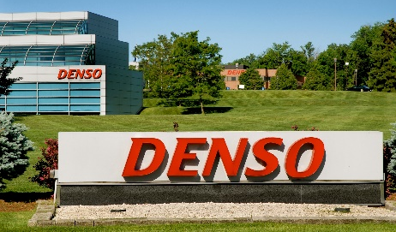
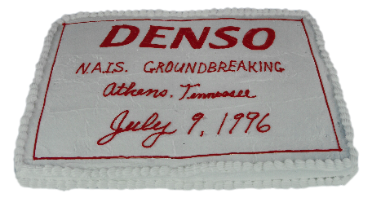
History of DENSO in North America
Detroit sales branch
Mexico Manufacturing Apodaca
1977
Maeda Named NA DENSO CEO
1996
First products sold in NA
Tennessee Manufacturing Maryville
Arkansas Manufacturing
Osceola
2021
NAQCC
Begins
DENSO Foundation established
1965
Canada
sales office
California Manufacturing Long Beach
1992
2003
Washington D.C. office
1988
2001
1972
1984
2017
1988
1971
North Carolina Manufacturing Statesville
1999
California sales office
Canada Manufacturing
Guelph
2011
Silicon Valley Innovation Center
1966
Chicago sales office
1985
Regional headquarters established
1996
Tennessee Manufacturing Athens
2019
Plano
Innovation Center
1984
Michigan Manufacturing Battle Creek
1971 | 1976 | 1981 | 1986 | 1991 | 1996 | 2001 | 2006 | 2011 | 2016 | 2022

Slide 24

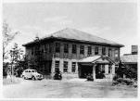
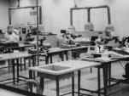
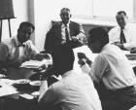
A Quick Guide to DENSO
1949
1956
1996
NIPPON ELECTRICAL EQUIPMENTS CO., LTD., later changed its name to NIPPONDENSO CO., LTD., split from Toyota Motor Co., Ltd., and was established as a separate entity
Created the mission statement on which DENSO is founded
Adopted our new corporate name, DENSO CORPORATION
Management
Foundation &
Policy
1953
1961
2017
Started technical cooperation with Robert Bosch GmbH of Germany
Received the Deming Prize,
one of the most prestigious
awards for quality control
Created the DENSO Group
Long-term Policy 2030
Technology
Development &
Manufacturing
1954
1968
1984
1991
2015
Established the Technical
Training Center
Established the IC Research Center
Opens Nukata Proving Ground
Opened DENSO Research
Laboratories
Establishment of the
global R&D system
1966
1972
2004
2016
Global
Deployment
Established a sales office in Chicago and branch offices in Los Angeles, USA
Established NIPPONDENSO (AUSTRALIA)
PTY. LTD., and NIPPONDENSO THAILAND
CO., LTD., our first manufacturing
companies located outside of Japan
DENSO Spirit
Introduced a global common
personnel management system

Slide 25
A Quick Guide to DENSO
Employees
Consolidated
Revenue
World-First
Products
Patents Held
170,000
$45.1 billion
over 130
41,500
Medals at the
WorldSkills
Competition
Overseas Revenue
Ratio
Global Network
69
35
countries
and regions
57%
As of March 31, 2022

Slide 26



A Quick Guide to DENSO
We are in the
pursuit of
"zero"
in the fields of
"green" and
"peace of mind."
CO2 ± 0
Zero traffic
fatalities
DENSO aims to be an inspiring company that creates a brighter future for all people through its commitment to being “green” and creating “peace of mind.”

Slide 27
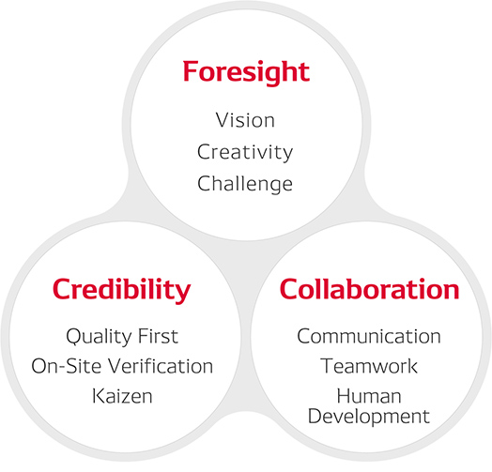
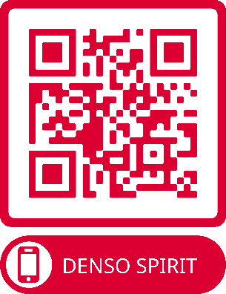
DENSO Spirit
The DENSO Spirit expresses values and beliefs shared by our employees around the world that have driven us to contribute to the automotive industry and society as a whole since our establishment in 1949.

Slide 28
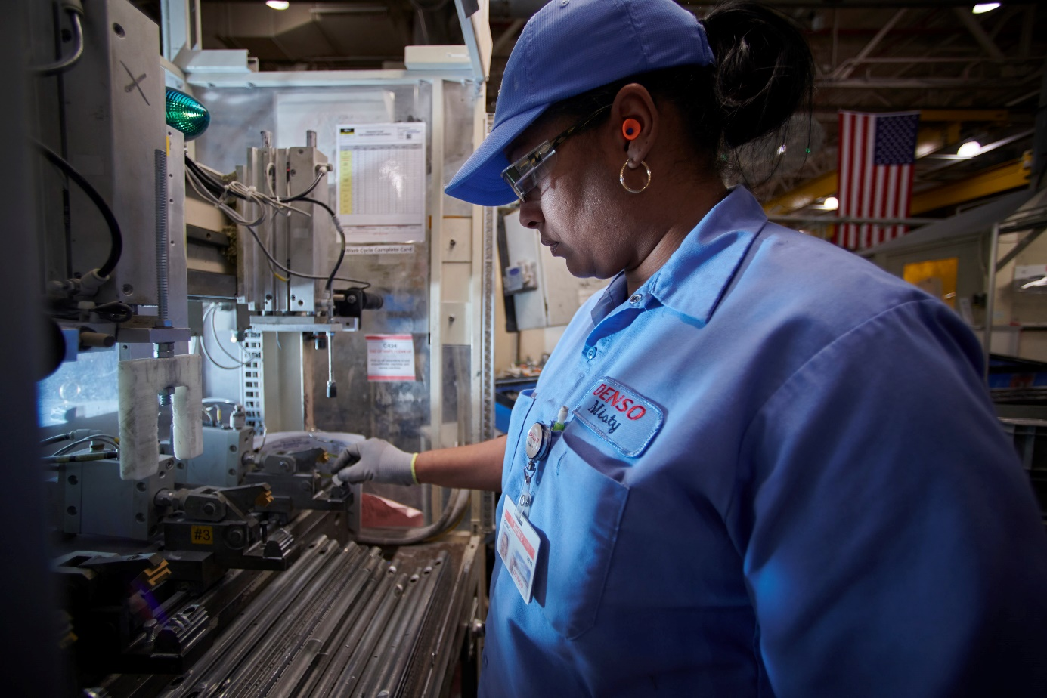
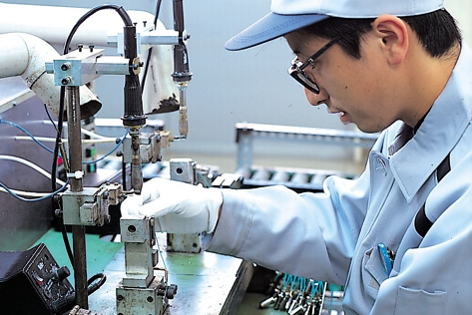
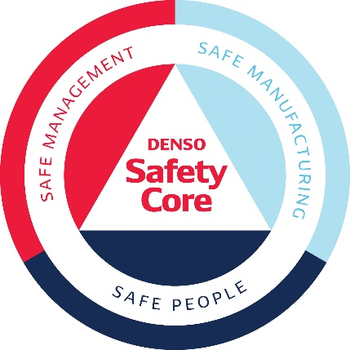
Safety and Quality First
Creating safe and comfortable working conditions is the best way to realize both human dignity and high productivity.
DENSO is dedicated to providing safe,
high-quality services that satisfy our customers using the Quality First principle.
Established by DENSO in 1969, our safety policy is built on the fundamental principles of safety, health, and the environment. The Safety Core graphic system is a symbolic visualization of these ideals.
The practice of quality assurance from the beginning of production and the promotion of quality control with full employee participation as basic quality assurance policies.

Slide 29
Crafting the Core is an expression of who we are and what makes us different.
It’s our relentless pursuit to get things done. We are purposeful innovators and proven problem solvers who use technology to address some of society's greatest challenges. We push boundaries and Craft value through the power of realization. At our Core are people who realize big ideas that bring hope for the future. We are DENSO. We are Crafting the Core.

Slide 30

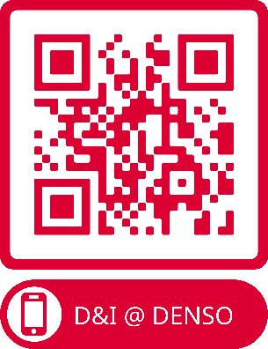
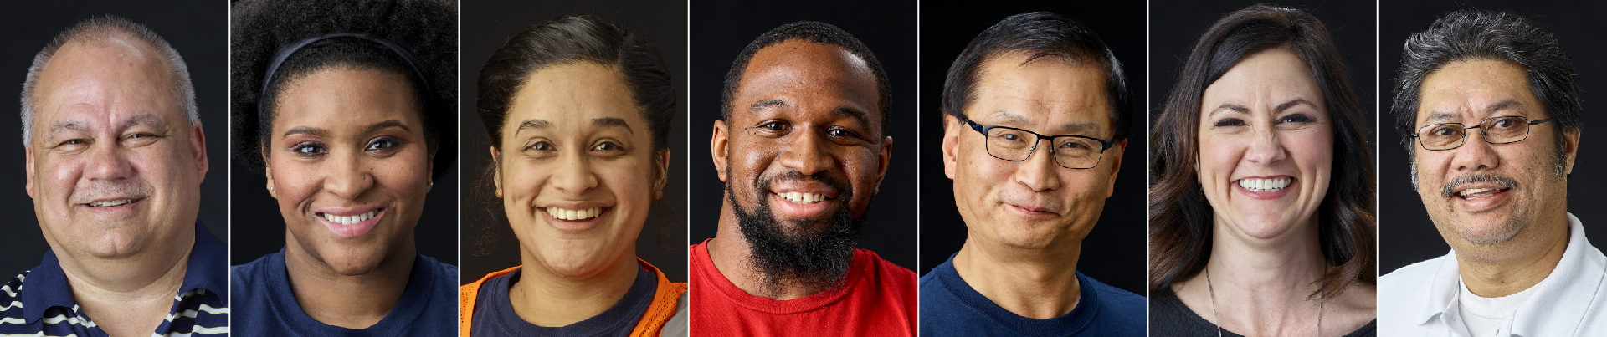


Value and embrace a diverse organization.
Create a fully inclusive culture for all with no walls or boundaries.
Inspire true innovation in mobility solutions.

Slide 31
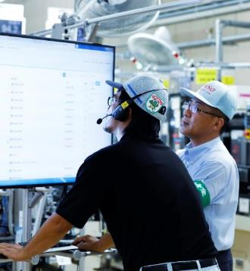
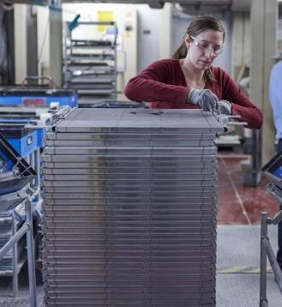
Monozukuri
Production Structure That Enables Mass Production of World-First and World-Only Products
Working to Improve Productivity That Connects People and Factories Globally
Promoting EF Activities Focused on Eliminating Product Defects and Lost Operational Time

Slide 32
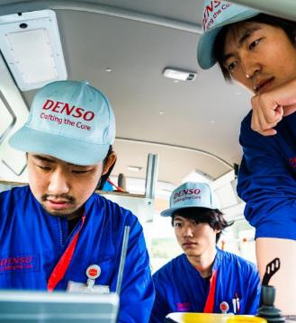

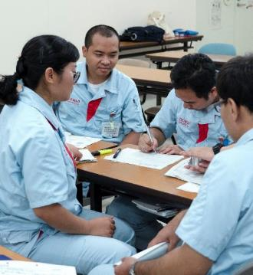
Hitozukuri
Introducing a Global Common Personnel Management System to Promote the Active Role of a Diverse Group of Employees
Boldly Taking On New Challenges No Matter What the Circumstances
Nurturing Advanced Technicians as the Key to Corporate Growth

Slide 33
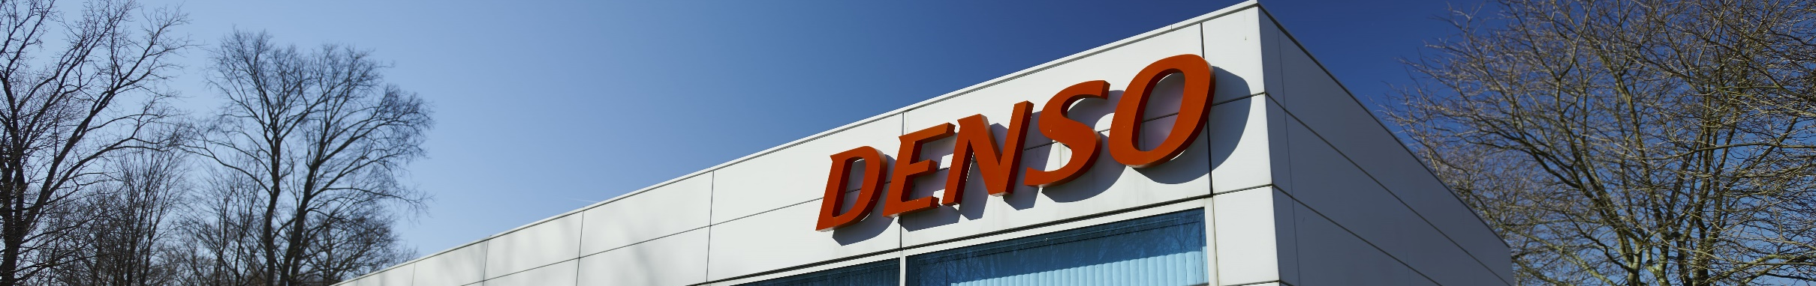
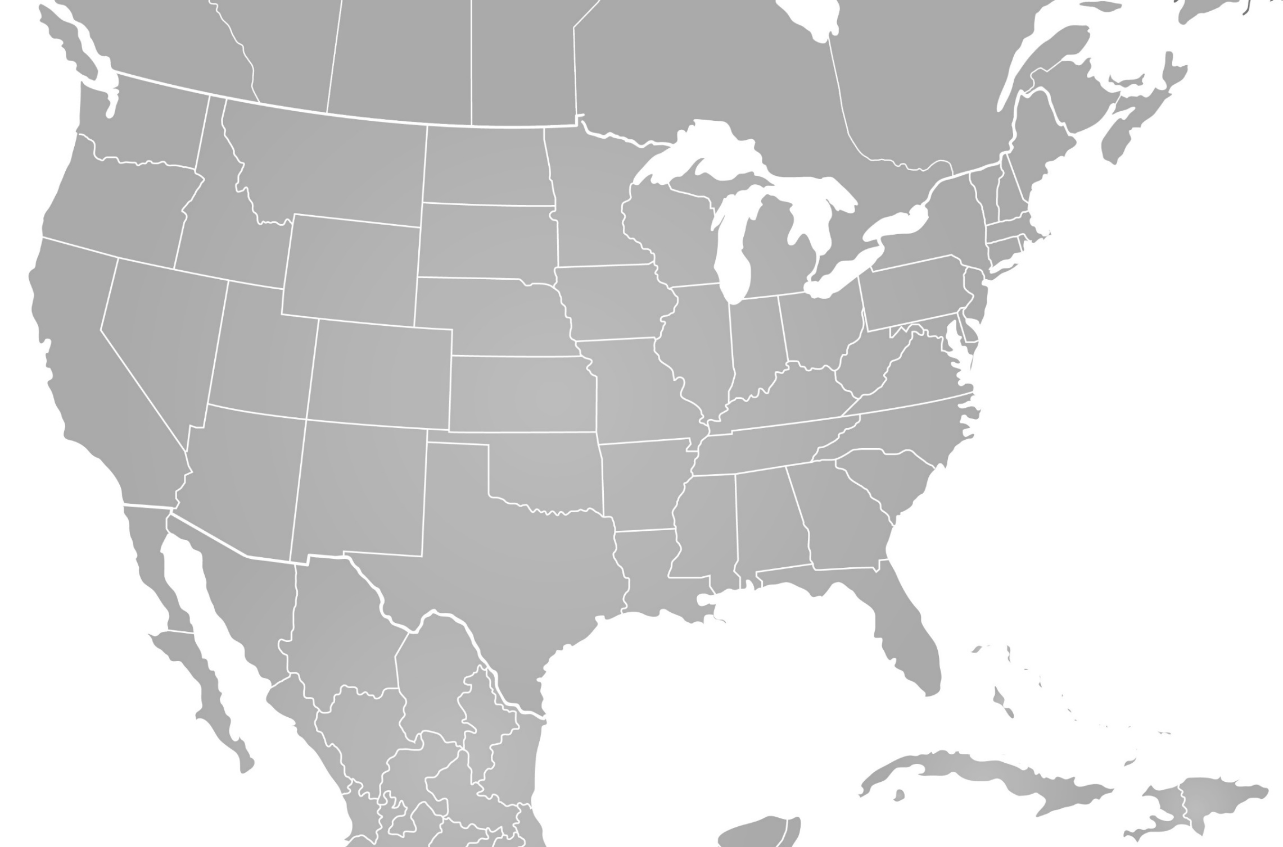
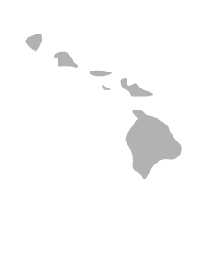
DENSO in North America
Established | 1966
Sites | 51
Consolidated Revenue | $9.5 billion
Operating Profit | $34.8 million
Employees | 23,604
2
2
Regional Headquarters
Southfield, Michigan
2
Aftermarket Headquarters
Long Beach, California
As of March 31, 2022
Logistics (5)
Production (14)
Joint Venture/Subsidiary (12)
Research & Development (10)
Sales/Services (10)

Slide 34
DENSO in North America
Logistics | Production | JV/Subsidiary | Research & Development | Sales/Services
Rancho Cucamonga, California, USA Charlestown, Indiana, USA (Jeffersonville) Belleville, Michigan, USA Mt. Juliet, Tennessee, USA Laredo, Texas, USA | Osceola, Arkansas, USA Murietta, California, USA Urbandale, Iowa, USA Battle Creek, Michigan, USA Battle Creek, Michigan, USA Greenville, North Carolina, USA Statesville, North Carolina, USA Athens, Tennessee, USA Maryville, Tennessee, USA Ennis, Texas, USA Guelph, Ontario, Canada Apodaca, Nuevo Leon, México Guadalupe, Nuevo Leon, México Silao, Guanajuato, México | Osceola, Arkansas, USA (Systex - SPARC) Torrance, California, USA (DENSO TEN) Pendergrass, Georgia, USA (TACG) Pendergrass, Georgia, USA (TICA) Hopkinsville, Kentucky, USA (ASKY) Battle Creek, Michigan, USA (Systex - SPC) Parma, Michigan, USA (MACI) Jackson, Tennessee, USA (TBDN) McAllen, Texas, USA (DENSO TEN) Monclova, Coahuila, México (DENSO Air Systems) Monterrey, Nuevo Leon, México (Hamaden) Reynosa, Tamaulipas, México (DENSO TEN) | Carlsbad, California, USA San Jose, California, USA Ann Arbor, Michigan, USA Jenison, Michigan, USA Southfield, Michigan, USA Mayfield, Pennsylvania, USA Pittsburgh, Pennsylvania, USA Plano, Texas, USA Seattle, Washington, USA Montreal, Quebec, Canada | Long Beach, California, USA Honolulu, Hawaii, USA Waterloo, Iowa, USA Southfield, Michigan, USA Dublin, Ohio, USA West Chester, Ohio, USA Plano, Texas, USA Seattle, Washington, USA Washington, D.C., USA Mississauga, Ontario, Canada
Notes:
MACI – Michigan Automotive Compressor, Inc.
SPC – Systex Products Company
SPARC – Systex Products Arkansas Company

Slide 35

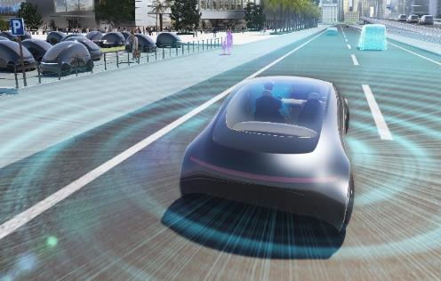
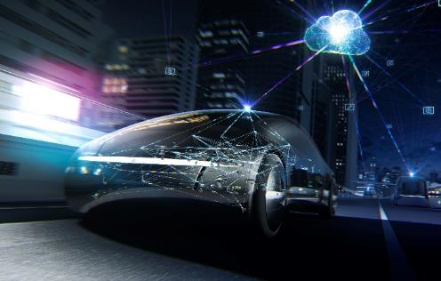
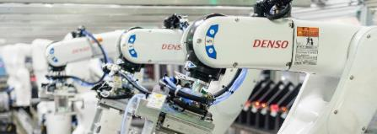
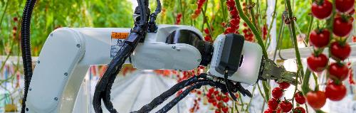
Four Focus Fields
DENSO is contributing to the improvement of both industrial and social productivity by working to provide new mobility value, establish factory automation (FA) and industrialize agriculture.
Advanced Safety and
Autonomous Driving
Electrification
Reducing
environmental burden
and realizing highly
efficient mobility
Realizing a safe society
without accidents,
and free and
comfortable mobility
Non-Automotive
Businesses
(Factory Automation and Agriculture)
Connected Cars
Realizing a new mobile
society that connects
vehicles, people,
and goods
Contributing to
improved social and
industrial
productivity

Slide 36
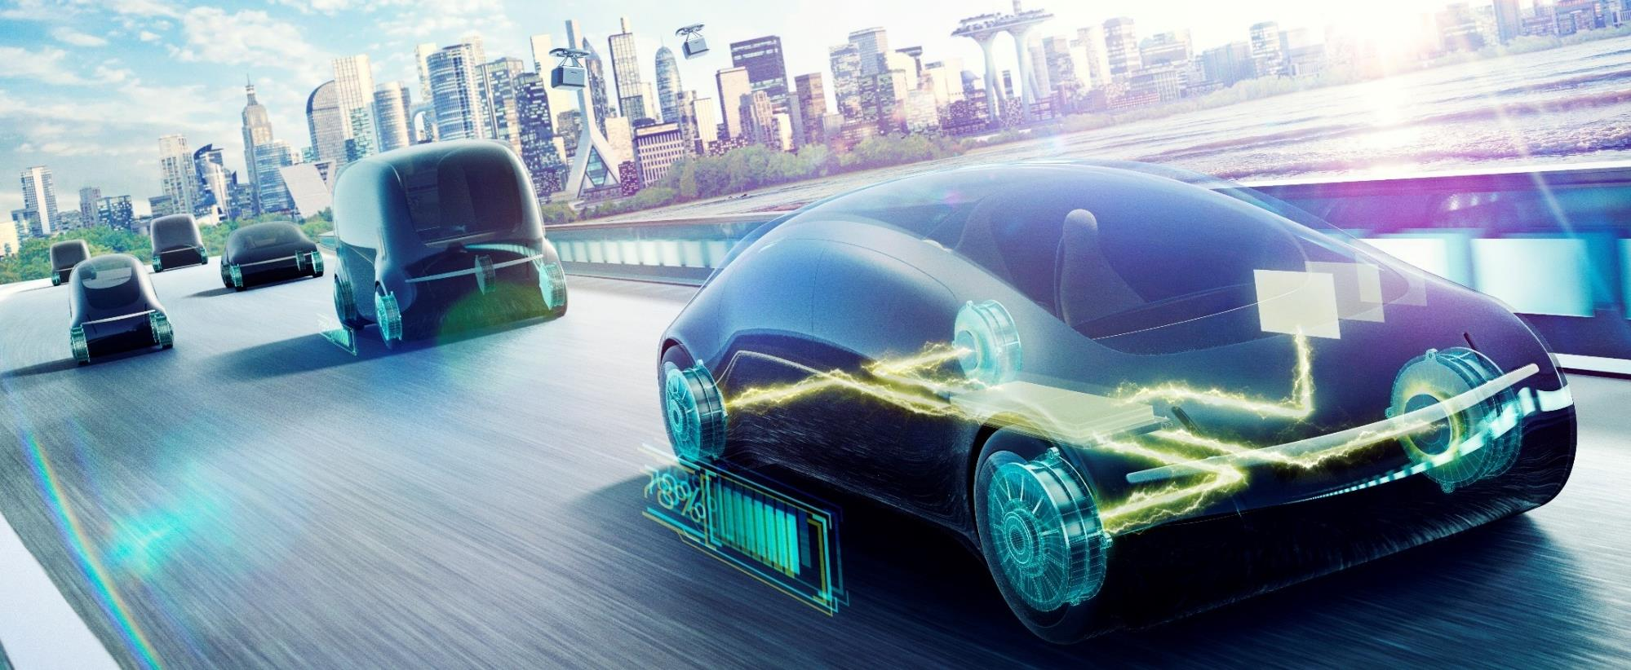
Electrification
DENSO will leverage our expansive business domains to form connections between various in-vehicle systems and products in an effort to efficiently manage energy within vehicles. In this manner, we will further improve fuel efficiency and contribute to the conservation of energy.

Slide 37
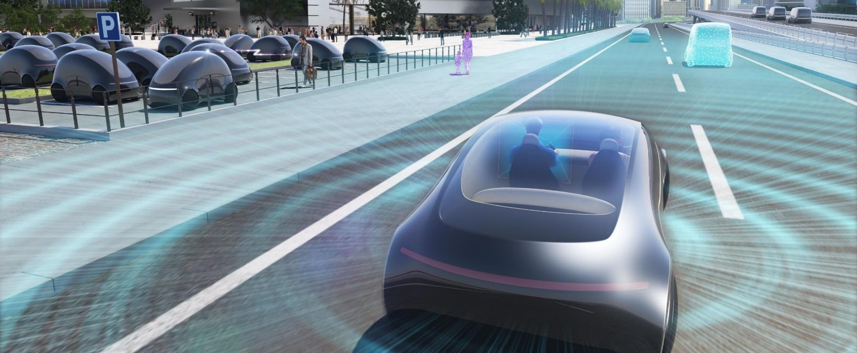
Advanced Safety and
autonomous Driving
By enhancing our long-cultivated sensing technologies as well as our AI and information technologies, we will further contribute to the development of autonomous driving technologies, and deliver genuine peace of mind for the future of mobile society.

Slide 38
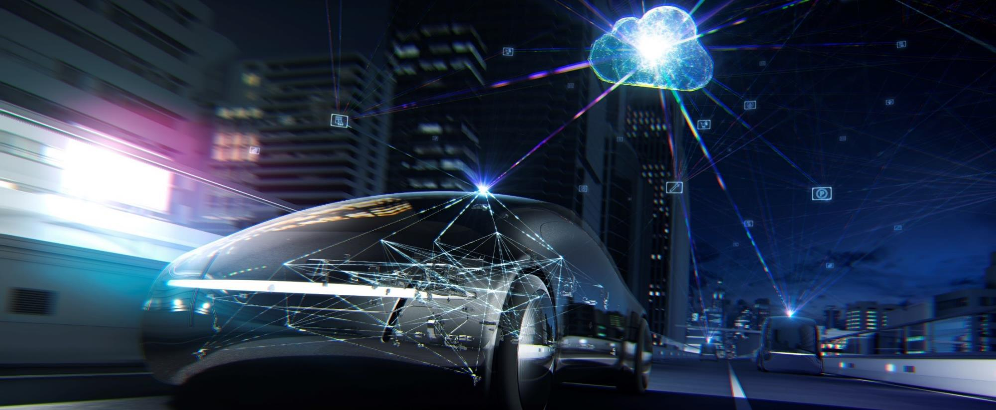
Connected Cars
DENSO is pursuing efforts in providing mobility services that are convenient, safe, secure, and efficient transportation methods with low environmental burden for people with vehicles and for those without, thereby contributing to the realization of a new mobile society.

Slide 39


Non-Automotive Businesses (Factory Automation and Agriculture)
DENSO provides Factory Automation systems that can meet the diverse needs of our customers, thereby making extensive contributions to the development of the manufacturing industry. We draw on the expertise and know-how we have cultivated in the automotive field to offer new value in agricultural fields.

Slide 40
























Main Products: Automotive Business
Thermal Systems
Powertrain Systems
Electrification Systems
Mobility Systems
Sensing System, Semiconductor
Car Air-conditioner
Direct Injection High Pressure Injector
Inverter
Stereo Vision Sensor
Solar Sensor
Water Cooled Intercooler
Common Rail Systems
Motor Generator
Millimeter-Wave Radar Sensor
Steering Torque Sensor
Radiator
Variable Cam Timing
Alternator
Driver Status Monitor
Matrix IR Sensor
High Voltage Water Heater
Accelerator Pedal Module
Wiper System
Engine ECU
Power Module for Automobiles

Slide 41









Main Products: Thermal Systems
Car Air-conditioner
Condenser
Evaporator
Heater Core
Water Cooled Intercooler
Radiator
Electric Compressor
High Voltage Water Heater
Electric Bus Air-conditioner

Slide 42












Main Products: Powertrain Systems
Direct Injection
High Pressure Injector
Direct Injection High Pressure Pump
Variable Cam Timing
Iridium Spark Plug
Ignition Coil
Oxygen Sensor
Substrate
Common Rail Systems
Accelerator Pedal Module

Slide 43









Main Products: Electrification Systems
Inverter
Motor Generator
Lithium-ion Battery Pack
Alternator
Starter
Lithium-ion Battery
Electronic Control Unit
Electric Power Steering Motor
Wiper System
Power Window Motor

Slide 44










Main Products: Mobility Systems
Stereo Vision Sensor
Millimeter-Wave Radar Sensor
Instrument Cluster
Head-Up Display Unit
Driver Status Monitor
Telematics Control Unit
DCM(Data Communication Module)
ETC and ETC2.0 On-Board Equipment
11.6-inch Touch Display
Engine ECU

Slide 45









Main Products: Sensing System, Semiconductor
Solar Sensor
Matrix IR Sensor
Intake Air Pressure Sensor
Engine Oil Level Switch
Steering Torque Sensor
Wheel Speed Sensor
Rain Sensor
Power Module for Automobiles
SiC Power Device for Audio

Slide 46










Main Products: Non-automotive business (Factory Automation, Agriculture, Industry/Home)
Automated Modules
QR Solution Services
Spot Cooler
Vertical Articulated Robot
Automated Harvesting Robot
(Under verification testing)
HEMS
(Home Energy Management System)
Collaborative Robots
Environmental Control Systems for
Greenhouse Cultivation
CO₂ Refrigerant Heat-Pumps

