Slide 1
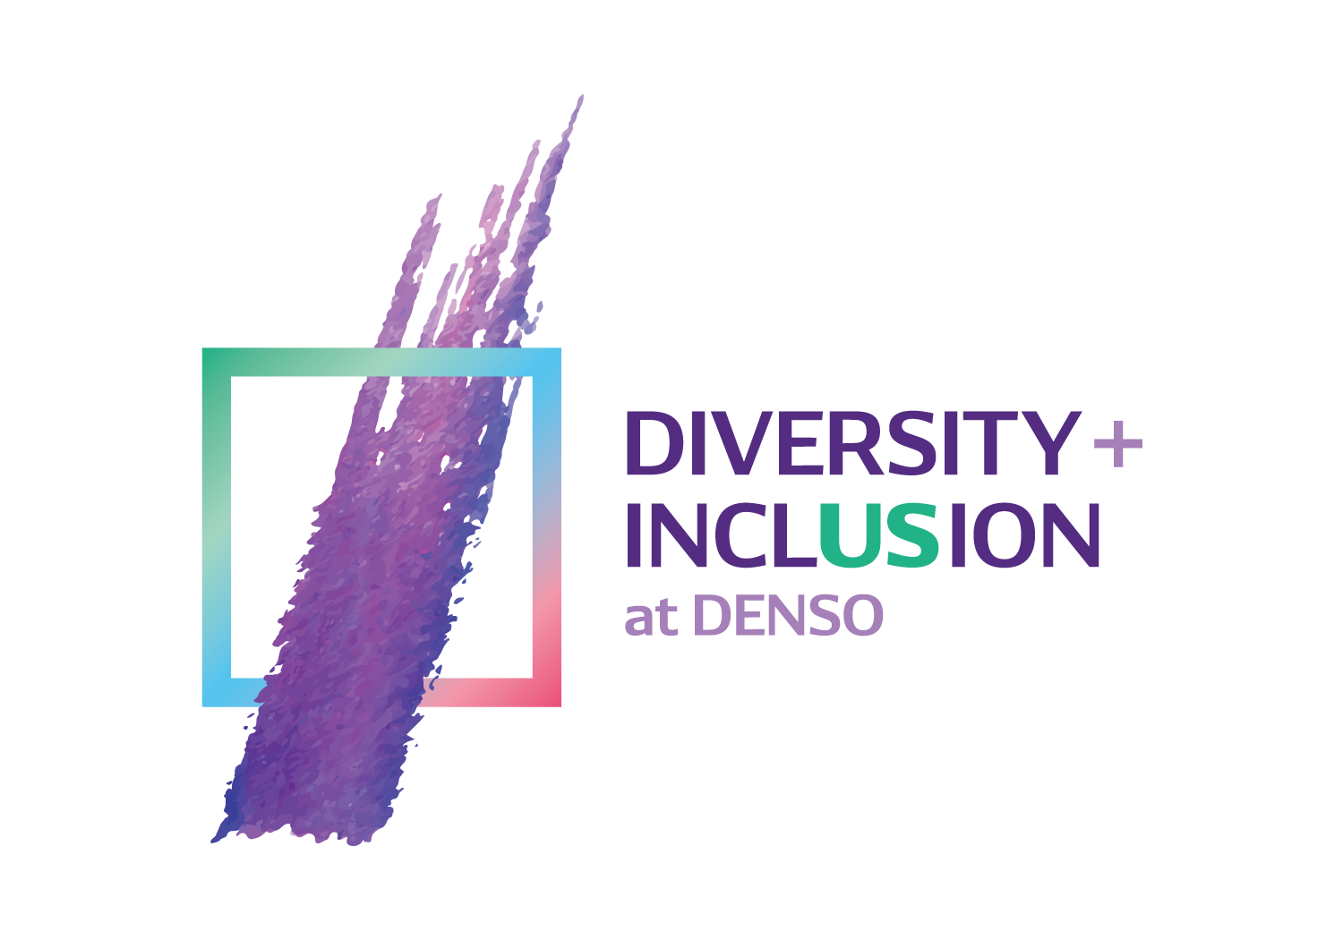
DENSO’s North America D&I Vision
To value and embrace a diverse organization and create a fully inclusive culture for all, with no walls or boundaries, to inspire true innovation in mobility solutions.

Slide 2
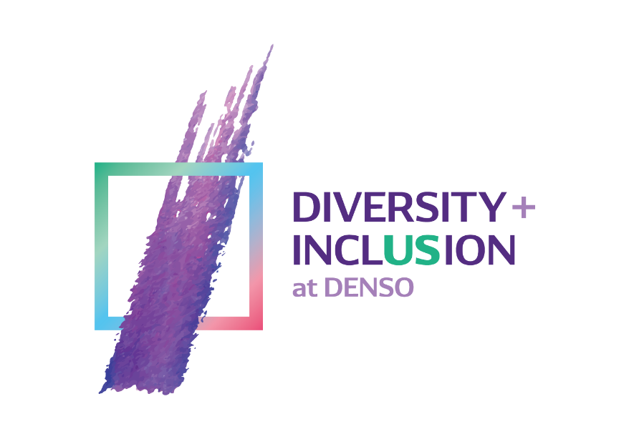
Diversity is MUCH more than visible attributes

Slide 3
Defining the I in D&I
Inclusion occurs when people know:
Their resources and talents are recognized and regularly utilized
Their differences are valued
They are fully able to contribute
They are welcomed, valued, respected and heard

Slide 4
Being Inclusive
Making people feel:

Slide 5
Defining the D in D&I
Diversity is the collection of our similarities and differences based on characteristics we are born with, experiences we have had, or choices we have made.

Slide 6
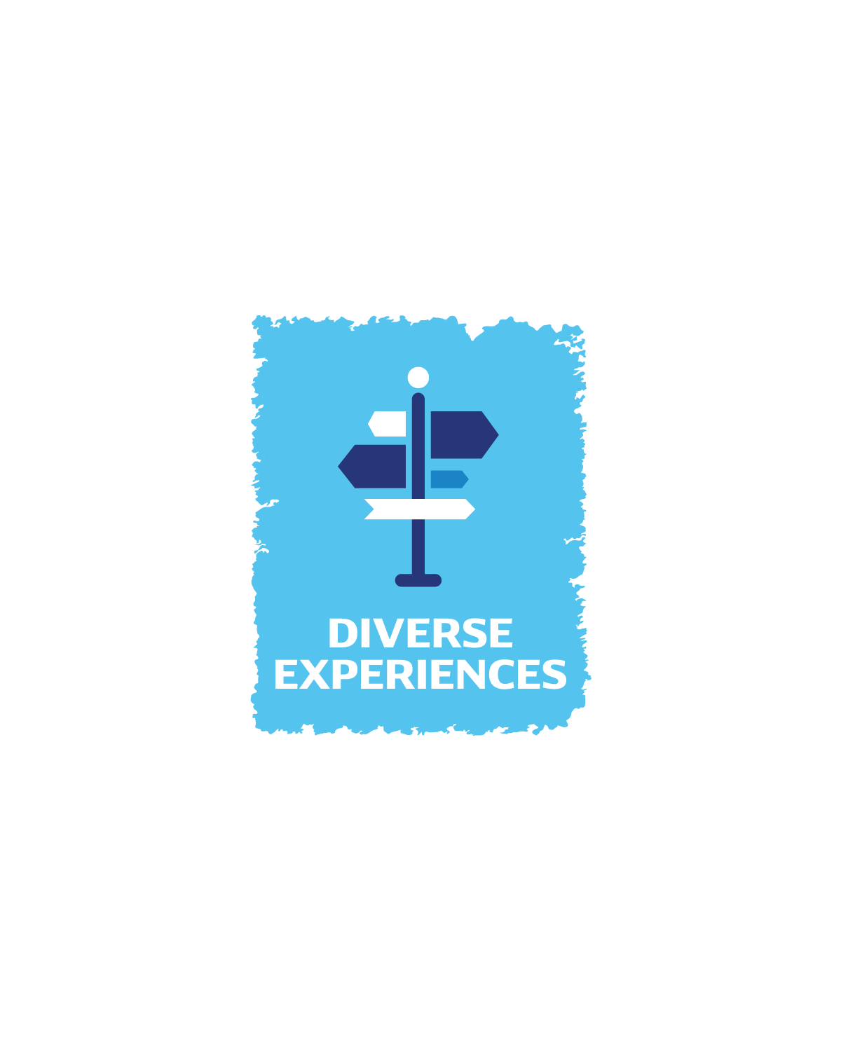
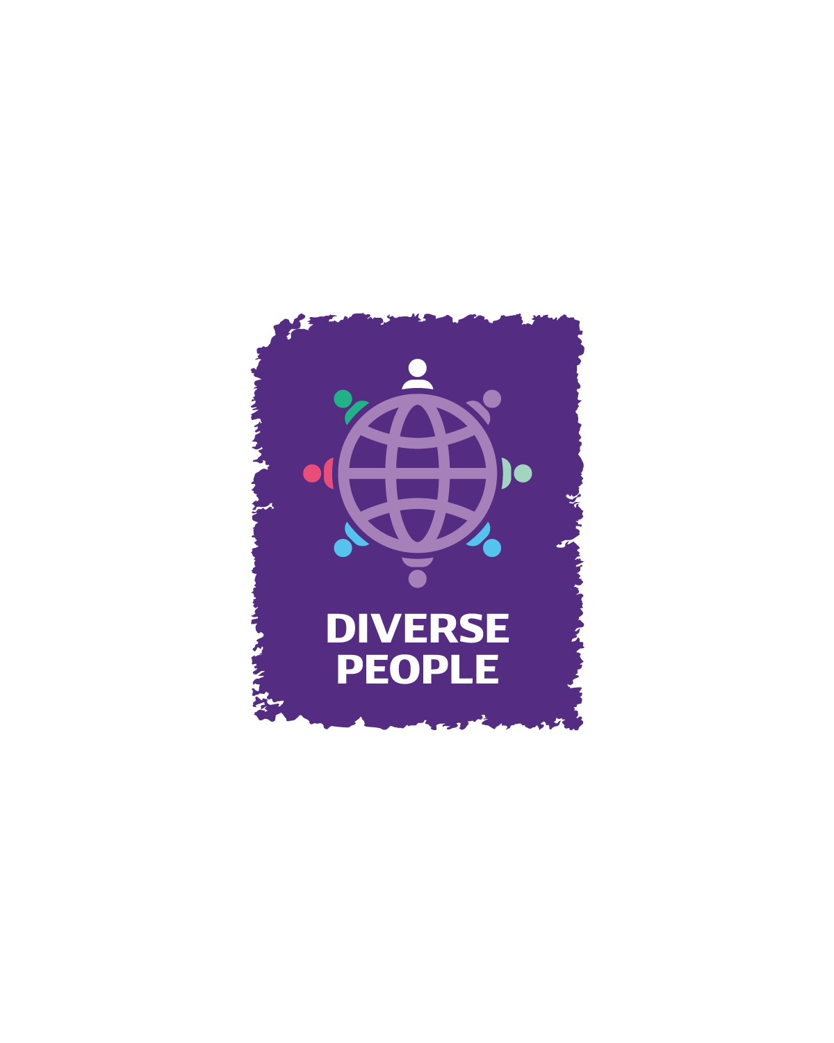
Creating Diversity

