Slide 1
Software Strategy
May 26, 2021
Shinnosuke Hayashi
Senior Executive Officer, CSwO
DENSO Corporation
DENSO supports the Sustainable Development Goals (SDGs).

Slide 2
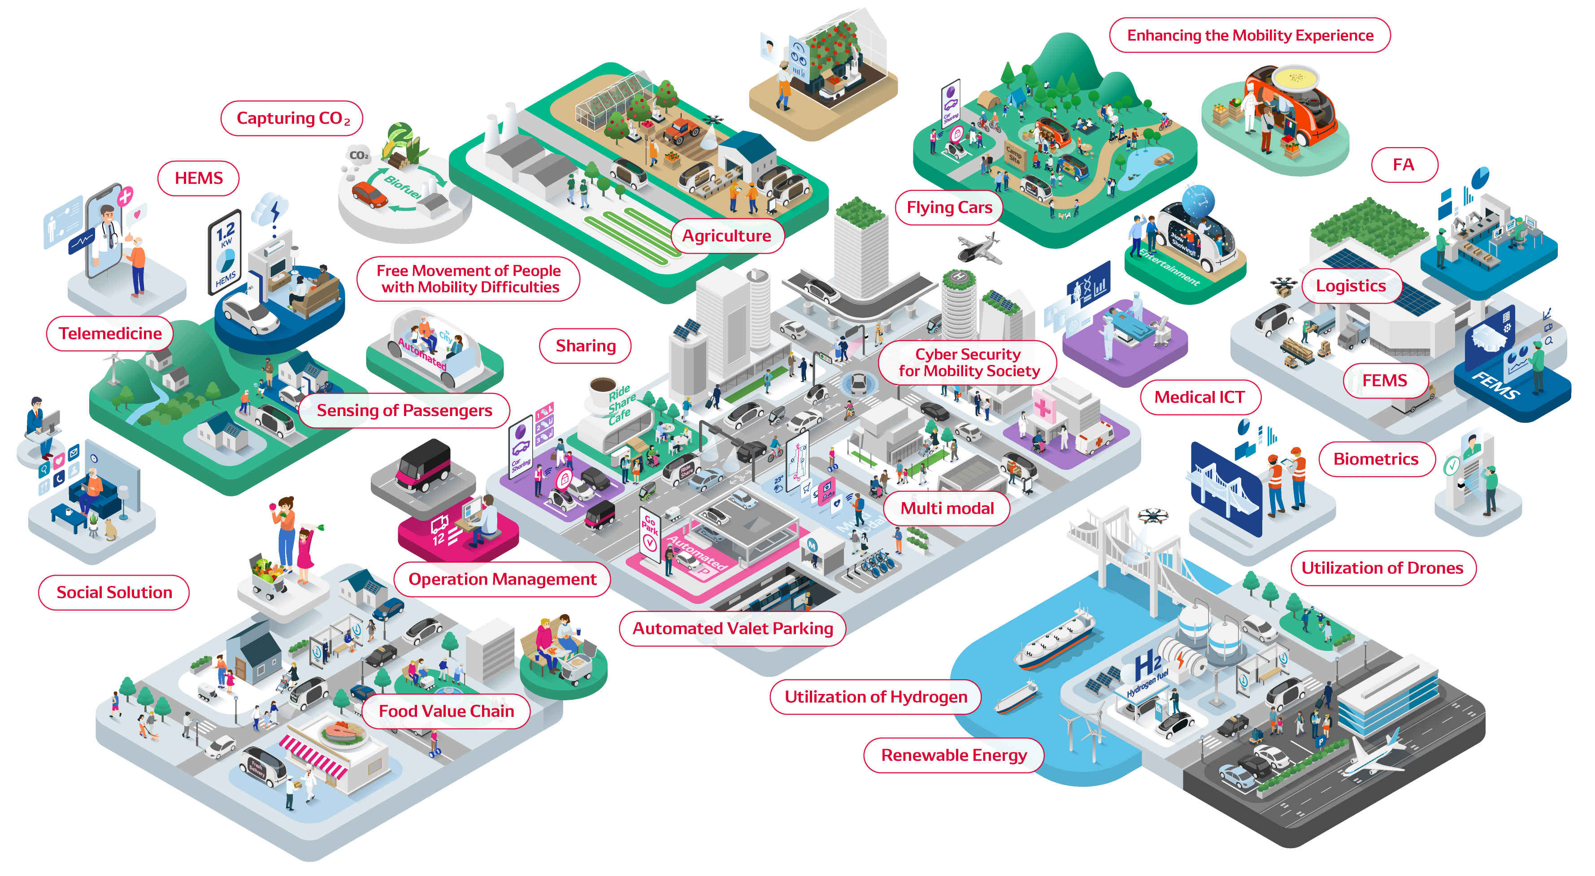
New Mobility Envisioned by DENSO
Green
Peace of mind
Roles of vehicles
・ Further evolution
Highly intelligent vehicles
・ Nodes of infrastructure
Vehicles serving as part of social infrastructure (as sensors and actuators of infrastructure)
Software is the key to achieving the vision.

Slide 3
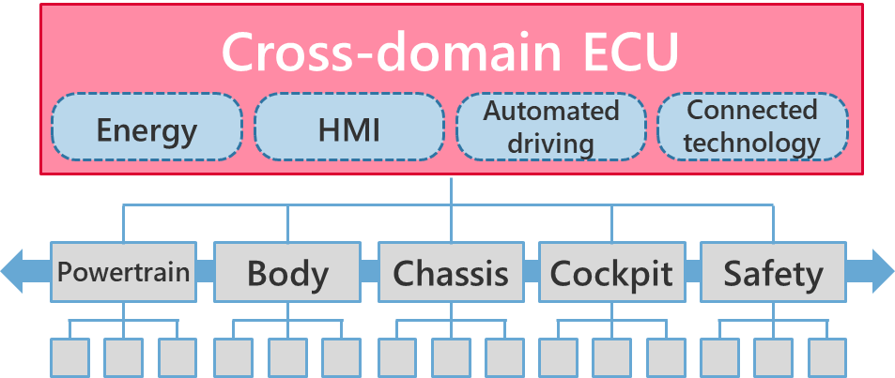
DENSO’s Progress toward Future Mobility
Past
Future
Evolution of each single domain
Cross-domain evolution
Single domain
Changes in the value proposition
Cross-domain
Competition of independent values
Changes in the social structure
Coordination in the ecosystem
Step up efforts in both cross-domain value and foundation
Title / Month XX, 2020 （『挿入』→『ヘッダーとフッター』から入力してください）
3
Notes:
<Past>
Vehicle has been evolved thanks to electronics technological progress as each single domain thorough 40 years history.
And basically, total vehicle value is evaluated as the result of the full integration of each single domain.
<Future>
Vehicle value will be evolved further by cross-domain control, such as Energy, HMI, ADAS and Connected.
Those value will be implemented into not only vehicle but also connected via cloud technology to gain the total ecosystem value, which will be lead to the market growth of Software/Cross domain ECU business.

Slide 4
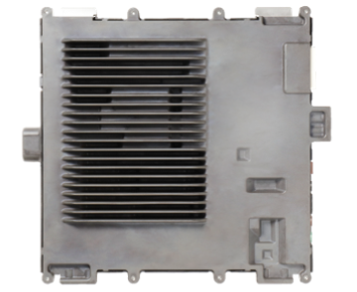
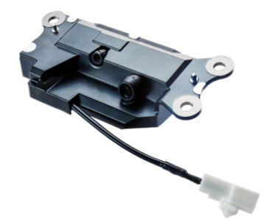
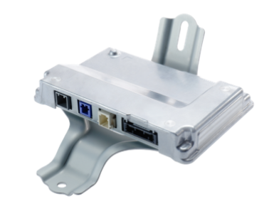
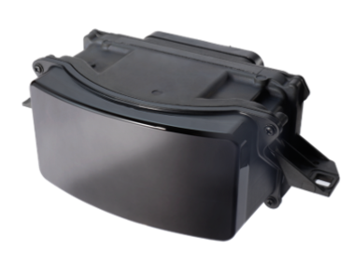
Offer cross-domain value
Development of a cross-domain system (example):
Advanced driver assistance products (marketed in April 2021)
Software
first
ADS ECU
ADX ECU
Vehicle level
viewpoint
Locator Telescopic Camera
SIS ECU
LiDAR
Electronic platforms
Distributed development of large-scale software systems
Integration with high enough liability
Architecture
Hardware/software separated architecture
Development methodology
Globally coordinated development environment
Quality
Security
Brain/limb ECU architecture
Model-based/virtual development
Fail-operational, Functional safety
Powertrain
Body
Chassis
Cockpit
Safety
DENSO’s strength
Software technologies and development know-how in all domains
Continue to lead the evolution of the cross-domain value based on DENSO’s proprietary technologies and development expertise
Notes:
DENSO has launched brand new advanced driving system in April 2021 and this is one of good example of cross domain value.
DENSO's strength has been cultivated deep dive technologies for long years history in each domain such as Powertrain, Body, Chassis, Cock pit and Safety.
As a result, DENSO grasped automotive use embedded SW technologies and development know-how in all domains.
Cross-domain system development are enabled by combination of these established expertise.
And DENSO added aspects of large scale software development with Software First, and vehicle level viewpoints.
Architecture, Development methodology (technologies) and Quality design are also very important to ensure .

Slide 5
Build the foundation of the industry standard
Platform connecting vehicles with IT
Priorities in development
Promoting standardization
Connection between vehicles and infrastructure
Enhance standardization activities (JasPar / AUTOSAR)
Interface between automotive technologies and IT
Promote standardized specification on vehicle architecture and interface between ECUs with OEMs
Connection in vehicles
Interface between the cross-domain ECU and respective ECUs
DENSO’s strength
Development experience and mutual trust with OEMs and mobility industry
Continue to help expand the ecosystem that reflects “green” and “peace of mind” through partnerships across the industry
Notes:
Additionally, DENSO has been established mutual trust with OEMs and mobility industry.
When we implement new system into the vehicle and/or society via platform connecting vehicle with IT technology,
two interface is the key of efficient and high reliable implementation.
One is Connection between vehicles and infrastructure, and the other one is Connection in vehicles.
DENSO will promote standardization by participating in standardization organizations (JasPar / AUTOSAR) and
make proposals through vehicle development experiences with various OEMs.

Slide 6
Changes in Human Resources and Organization
Human resources
Organization
Recurrent training of software developers (from January 2021)
Development of a cross-domain organization (from June 2021)
Integrated control of software development
through a cross-functional organization
Establishment and deployment of recurrent training system
(skill definition, education curriculum, accreditation system)
Electronics Platform and Software Function Unit
Accelerate two shifts towards 2025
Mature field → Growth field
Electronics
Cockpit
AD&ADAS
Telecommunications
Electronics
AD&ADAS
Telecommunications
2,000 engineers
Cockpit
Hardware → Software
1,000 engineers
Enhance cross-functional collaboration
Encourage engineers to innovate own career,
in the organization that gives opportunities to play an active role
Notes:
DENSO will enhance these activities by proper HR resources and Organization.
<Human resources>
- Introduced reccurent training program for software developers from Jan. 2021.
- It will support two resources shift, Mature field to Growth field and Hardware field to Software field.
<Organization>
- Start new cross-domainorganization named "Electronics Platform and Software Function Unit" from Jun. 2021.
- This organization structure will activate cross-domain development and cross-functional collaboration under
unified software direction.

