Slide 1
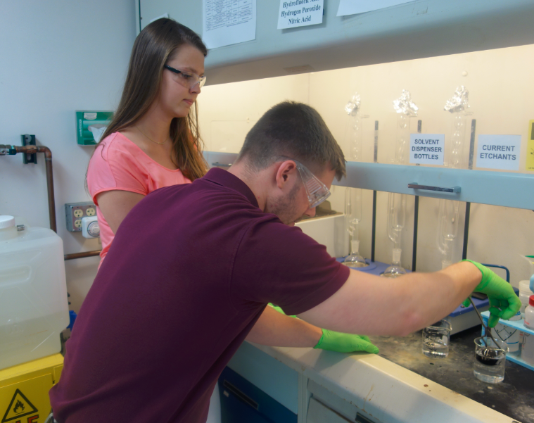
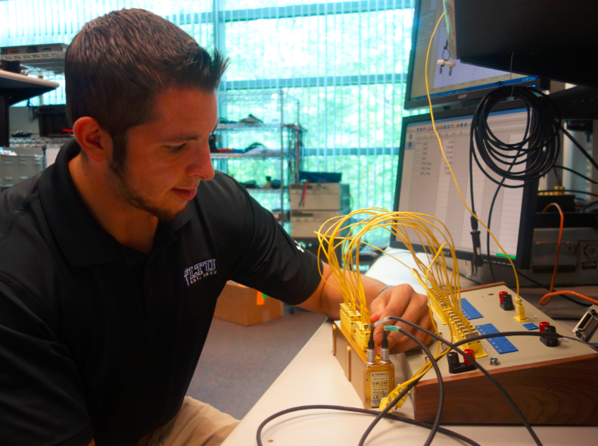
Purpose of Co-op Program
As a Co-op/Intern student at DENSO, you will have a first-hand opportunity to apply what you have learned in school, as well as explore various career paths.

