Slide 1
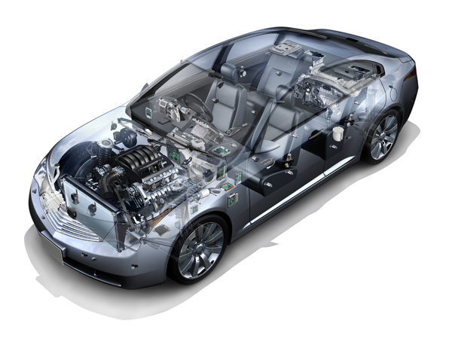
Product Group 2 – Eco-friendly Powertrain and Fuel Economy
Engine Management Systems & Controls, Powertrain, Hybrid, Engine Electrical
● Powertrain Related Products
Engineering management system, electronically-controlled diesel system, starter, alternator, etc.
PG2 TECHNOLOGY!
Stop-Start Technology
Lithium Ion Battery Packs
Hybrid components
Gasoline Direct Injection (GDI)
DENSO is focused on technology that will meet future fuel emission standards while meeting performance for North American customers!

